Slide 1
Efficient Format for Thing Description
Taki Kamiya (Fujitsu), Daniel Peintner (Siemens)
17 March 2020

Slide 2
What We Discussed Before
The WoT IG mainly looked at two technologies for compacting TDs.
W3C EXI4JSON
A very compact encoding for JSON based on W3C EXI.
Working Group Note is available.
https://www.w3.org/XML/EXI/docs/json/exi-for-json.html
Implementations are also available. (e.g. EXIficient, OpenEXI)
IETF CBOR
Compact encoding for JSON.
Implementations available in many languages.
What we have learned so far.
CBOR processors (parsers/encoders) are probably easier to implement.
Modestly compact.
EXI4JSON
In general, it provides more compact encoding.
It can be informed by JSON schemas for better compaction.
Note: “informed” is different from “dependent”
It works better when combined with redundancy-based compression (e.g. deflate algorithm)

Slide 3
TD is Metadata, is not Payload
TD is to the IoT what index.html is to a website
It can be considered as the entry point of a physical or virtual Thing/device.
TD is a collection of metadata.
It is a format for metadata, not necessarily is a format for payloads.
For payloads, TD can identify various payload formats by content-type.
For payloads, TD is open-ended as long as the format is well-documented.
In Burlingame F2F in 2017, WoT transformation language was suggested by participants.
An example mechanism supporting such transformation for CSV and ASN.1 was presented in 2nd WoT Workshop.
TD, as a format of metadata, should be able to be processed by as many WoT Consumers as possible.
We probably should not make it open-ended.
We should recommend at most a couple of efficient encodings (ideally, one) to manage interoperability.
At the same time, we should expect changes in technology in terms of innovation, trends, etc.
We should not forbid the use of formats that will be available in the future.

Slide 4
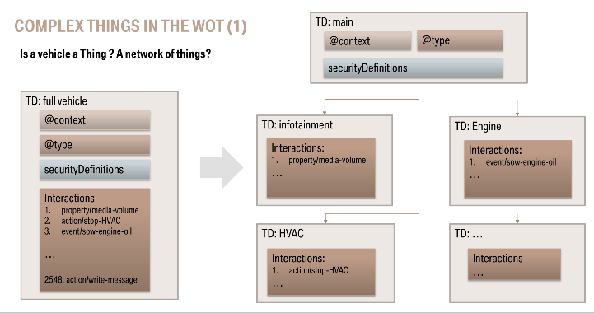
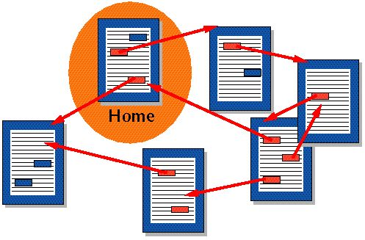
TD is Hypertext
Hypertext (from Wikipedia)
by Benjamin Klotz (Eurecom) @ 2nd W3C Workshop on WoT
TD can link to other TDs and Templates.
Main TD (“Home” in the figure) can be in an efficient format.
But other TDs may be the default text JSON-LD.
For a TD composed of TDs for “components”, collecting them all requires multiple retrieval of resources.
It may reduce the gains from an efficient format.
Thing Directory may provide support for efficient formats.
This way, linked TDs can also be accessed in an efficient formats.

Slide 5
Encoding at Different Layers
From the bottom to the top (see left figure from the bottom)
Byte level
Deflate, GZip, etc. detect redundancy at byte level, and compress them.
Syntax level
EXI4JSON, CBOR, etc. work at the token level according to JSON grammar.
Data model level (e.g. RDF triples)
RDF Thrift, HDT, etc. works at the triplet level according to RDF grammar.
Information model level (e.g. WoT)
It would work on TD information model described in TD specification.
The higher a level is, it is more useful for high layer processing.
However, such a format is not useful for software expecting lower level processing.
For example, WoT consumer that processes TD as pure JSON may not be able to process TDs encoded at RDF level.
The right level depends on use cases and device classes.
Information Model (e.g. WoT)
data model (e.g. RDF)
Syntax (Token/Grammar)
Bytes

Slide 6
Thing Directory and Thing-to-Thing Use Cases
Thing Directory Use Case
WoT consumer obtains a TD from Thing Directory.
Using SPARQL or Semantic API.
Thing Directory and WoT Consumer are talking based on abstract semantics.
It may be more convenient for the Consumer to receive TD in a format encoding TD data in RDF data model.
Thing-to-Thing Use Case
A Thing with limited resources may prefer to hold TD data in very compact form such as EXI4JSON or CoAP.
TD
Thing Directory
Registration
Thing
Query
TD
TD
Interaction
WoT
Consumer

Slide 7
Next Steps
Efficient Format is an optimization issue, not a functional issue.
It only surfaces in a real system or in stress tests.
We should recommend at most a couple of efficient encodings (ideally, one) to manage interoperability.
At the same time, we should not forbid the use of formats that will be available in the future.
Ultimately, market will find the best option.
However, we should avoid the chaos. WoT was about removing chaos.
We can experiment most promising formats in future PlugFests.
We should avoid inventing a new format unless there is no better alternatives.
We continue discussions on GitHub https://github.com/w3c/wot-thing-description/issues/885

Slide 8
Thank you!

