Slide 1
Managing Big Data with privacy in mind
Bert Bos W3C Track at WWW 2017, Perth (Australia), 6 April 2017

Slide 2
Two related projects
Two research projects:
BDE, 2015‒2017: general platform for big data
SPECIAL, 2017‒2019: privacy for big data
By W3C and ERCIM (European host of W3C), in cooperation with a number of partners.

Slide 3
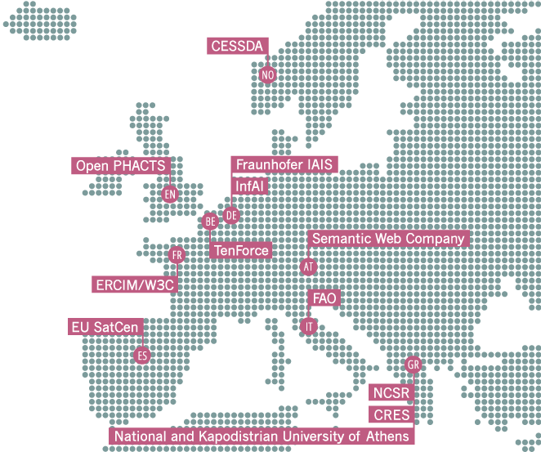
Big Data Europe: Consortium

Slide 4
Big Data Europe: Funding

Slide 5
What is Big Data?
‘Data too big to process with a single computer.’

Slide 6
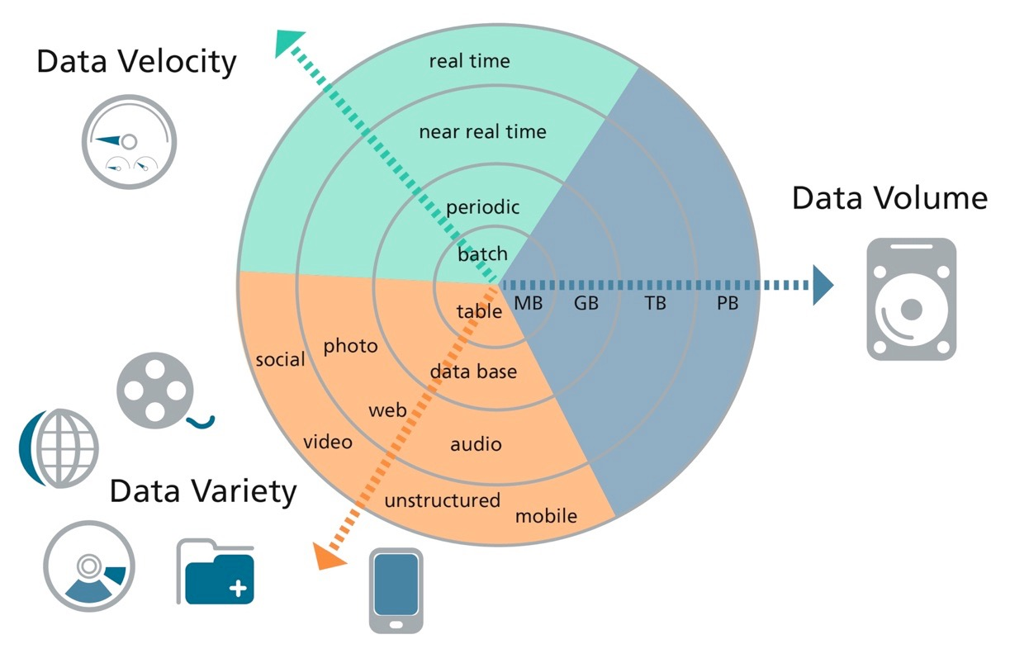
The three V’s
Velocity
Volume
Variety
Source: Gesellschaft für Informatik
… but Variety is often neglected.
Notes:
http://www.gi.de/nc/service/informatiklexikon/detailansicht/article/big-data.html

Slide 7
Handling ‘Volume’ & ‘Velocity’
Use specialised software
HFDS, Spark, Flume, etc.
Use parallel computing
BDE provides these and other software as Docker containers → easy to deploy on a ‘swarm’ of machines → scalable to many nodes.

Slide 8
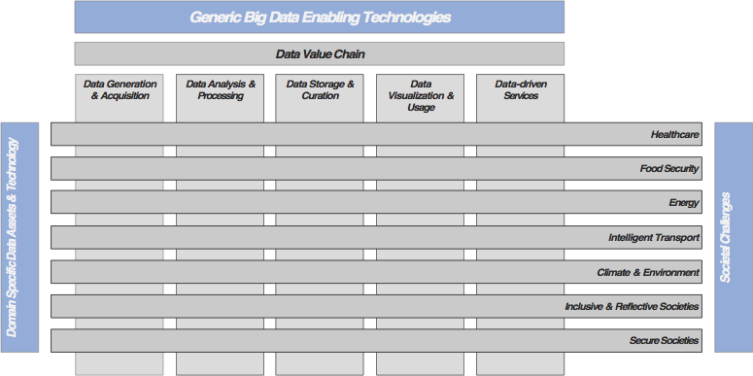
’Variety’

Slide 9
Handling ‘Variety’
How to handle different kinds of data, and even correlate them.
Answer: metadata
(a.k.a., Semantic Web, RDF, LD, LOD… Did you expect a different answer in the W3C Track? ☺︎)

Slide 10
RDF and SPARQL
Metadata tells how to process the data
Allows to view the data as RDF → allows SPARQL queries
But:
Most data isn’t actually converted to RDF
Instead, the query is translated

Slide 11
Who owns the data?
Addition under consideration:
Metadata about permissible actions on data
Could be ODRL.
(ODRL should be a W3C Recommendation by the end of the year.)

Slide 12
On to SPECIAL
And that brings us to privacy…
… and SPECIAL

Slide 13
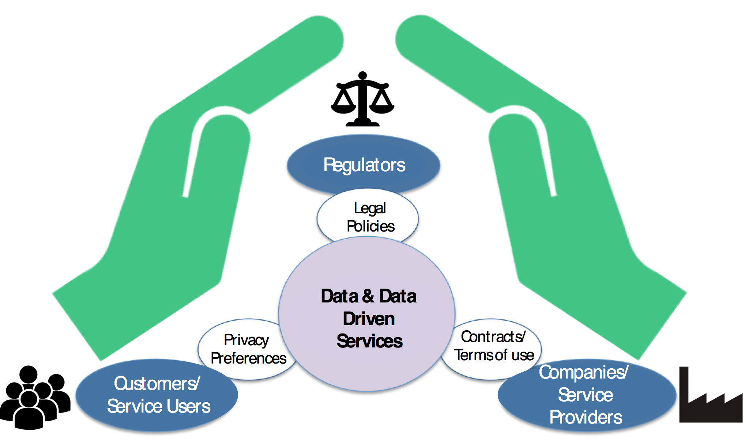
SPECIAL: Consortium

Slide 14
SPECIAL: Funding

Slide 15
Metadata (again)
Builds on Big Data Europe
Privacy added by means of metadata
In particular: a model of the EU General Data Protection Regulation (consent, anonymisation, erasure, etc.)
(It’s a European project, after all)
which should come into force in 2018
But likely useful outside EU

Slide 16
Additional modules
Also:
Tools to import privacy policies in different formats
Tools to anonymise data
Tools to visualise & explain policies
Versioning of policies

Slide 17
The end
SPECIAL https://www.specialprivacy.eu/
Big Data Europe https://www.big-data-europe.eu/
Bert Bos <bert@w3.org> GPG fingerprint: 7744 0204 52A5 14D9 147D 2A13 2D7A E420 184B 5BA4
https://www.w3.org/Talks/2017/0406-BDE-SPECIAL-WWW2017

