Slide 1
Discussion: Convergence of the Multilingual Web and Linked Open Data 11 June 2012
Dave Lewis
Felix Sasaki

Slide 2
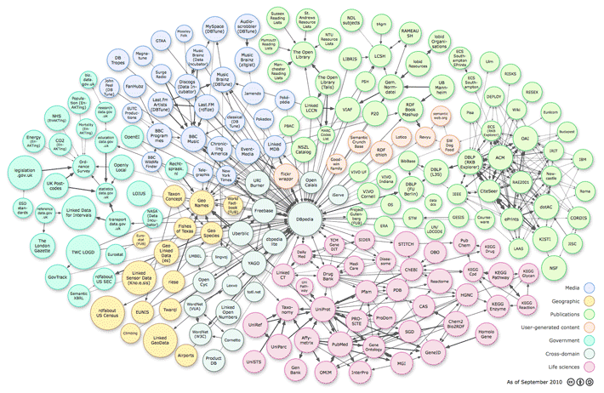
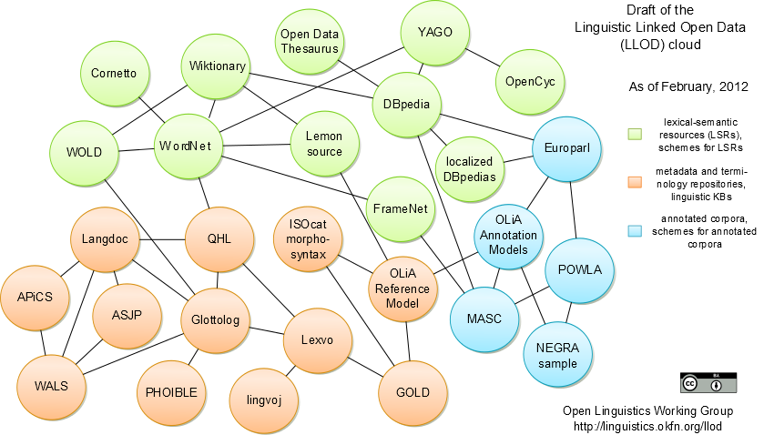
MLW and LOD
Language Resource Community
Language Technology Community
TM+TB
Multilingual Web
Localisation Industry
Notes:
Language technologies encompass two somewhat parallel groups
Language research, where language resource communities has evolved, in large part to support the language technology research community.
In parallel we have the more commercial world of Web content providers striving to make their content accessible in multiple language, served by the localisation industry. The localisation industry already relies heavily on assembling and reusing language resources in the form of term bases and translation memories.
We now see the localisation industry getting switched onto the benefits of language technology, primarily in the form of SMT, as are the content providers with direct use of SMT.

Slide 3
Roadmap - Opportunities
Sharing open language resources as LOD
Interlinking LR and stand off QA, e.g. For training SMT or Text analytics
Pooling TM & TB as enterprise linked data
Improve data management and integration
Quality Meta-data when harvesting language resources from the web
Provenance annotation
Localising Linked Data
Cross language interlinks

Slide 4
Roadmap - Challenges
Use and business cases
Why bother? Why invest? Why change?
Multiple paths:
LEMON, NIF, LMF, TBX/RDF....
Sourcing LR resources
Public sector bootstrap + commercial value add?
Accessibility of LR and LT to SMEs
Simplicity, tools, training, best practice
Progressive access control
Enterprise data access to open data access
Different velocities
2 yrs = 0.5 phd = 8 quarterly reports

Slide 5
Discuss?

