Slide 1
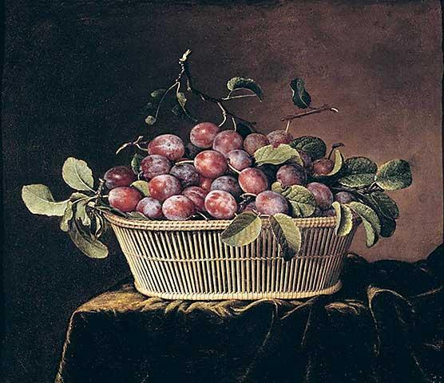

Implementation
Basket
Moderator:
Felix Sasaki (DFKI / W3C Fellow)
Notes:
As said before, you will see many people on stage in this session. They will present you a “basket full of ITS 2.0 implementations”. Their work has been extremely fruitful. The picture on this slide will set you in the right mood to taste the delicious outcome of the work.

Slide 2
What is in the basket?
Tools to support work with ITS 2.0
  ITS 2.0 in editing environments
  Generate and validate ITS 2.0
  (Automatically) process ITS 2.0 enhanced content
What the audience should do
  Think about the area that interests you
  Remember faces and use META-FORUM for hallway conversations

Slide 3
ITS 2.0 in editing environments
In the CMS 1: Adobe. Presenter: Felix Sasaki
In the CMS 2: Cocomore. Presenter: Clemens Weins
In a word processor: ]init[. Presenter: Steffen Haller
In a Web content editor: Disruptive Innovations. Presenter: Daniel Glazman

Slide 4



Implemented Data Categories
Adobe’s ITS2 Implementation
Translate
Localization Note
Id Value
Target Pointer
Adobe’s fully open source implementation imports and exports content enabled with ITS2 metadata to/from a JCR Content Repository
XML (xliff)
html5
Accessible via ‘selector’ REST URLs. E.g.:
To access content:
GET http://myhost/my/content/file.html
REST
Framework
To access the same content, ITS Enabled :
GET http://myhost/my/content/file.its.html
CMS
Notes:
Adobe has created one CMS implementation of ITS 2.0. The implementation allows to import and export XML (e.g. XLIFF) or HTML5 content out of the Apache Jackrabbit CMS. The slide shows an example how to access content in an ITS enabled manner. This implementation is useful for two reasons: first, it eases work with ITS 2.0 for content creators in the CMS – an important tooling area to foster ITS 2.0 adoption. Second, the implementation has been developed by a large company with a complex localization workflow in mind. This very well complements the CMS work done by Cocomore, see the next presentation by Clemens Weins from Cocomore.

Slide 5



Build the bridge Web CMS <> TMS
XHTML + ITS 2.0
LSP
Drupal ITS 2.0 integration https://drupal.org/project/its
JavaScript ITS 2.0 parser http://plugins.jquery.com/its-parser/
Real life ITS 2.0 showcase with VDMA and LSP (Linguaserve)

Slide 6
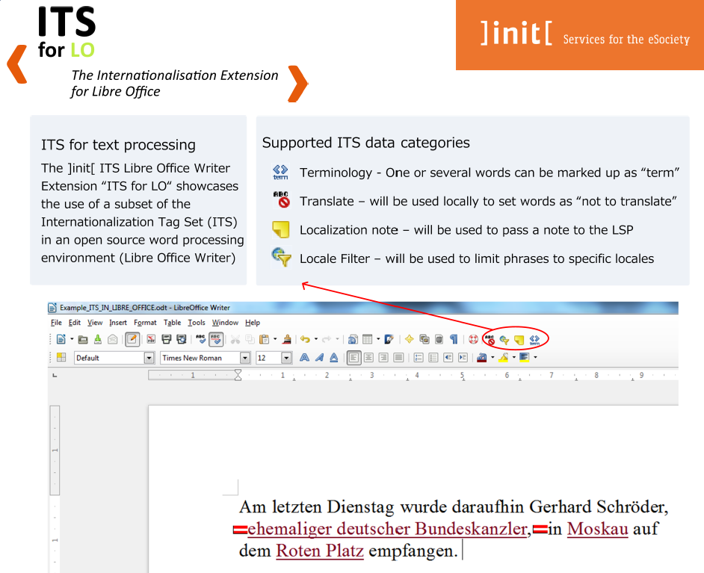
ITS Libre Office Extension
]init[ AG für Digitale Kommunikation
Downloadable at
Libre Office Extension Centre:
http://extensions.libreoffice.org/extension-center
Open Source GPL v3
free to use and to be developed further
More on:
http://www.init.de/en/libreofficeWriter

Slide 7
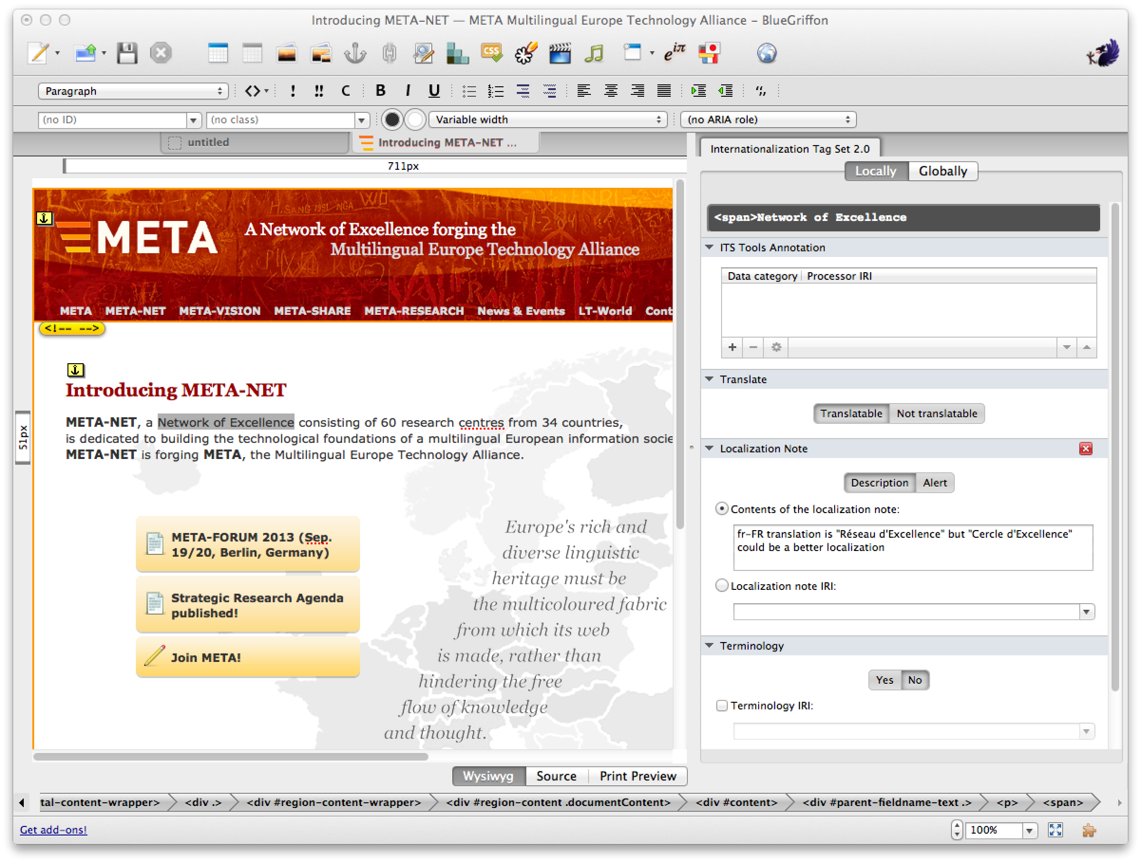
http://bluegriffon.org

Slide 8
Generate and validate ITS 2.0
Generate Terminology: Tilde. Presenter: Felix Sasaki
Generate Text Analysis information: Institut “Jožef Stefan”. Presenter: Felix Sasaki
Transform HTML5+ITS2 to NIF (NLP Interchange Fformat): Univ. of Leipzig. See on NIF poster from Sebastian Hellmann
Validate all ITS 2.0 data categories: University of Economics Prague. Presenter: Jirka Kosek

Slide 9

ITS 2.0 Enriched
Terminology Annotation Showcase
taws.tilde.com
Notes:
ITS 2.0 Enriched Terminology Annotation Showcase
The showcase allows users to automatically annotate terminology in the ITS 2.0 enriched content in:
HTML5, XLIFF, and plaintext formats.
The users of the showcase can be:
human users, e.g., translators, terminologists, and others;
as well as machine users – machine translation systems, terminology management systems, computer-aided translation tools, and others.
ITS 2.0 content analysis and terminology annotation for the showcase are performed by a dedicated Terminology Annotation Web Service API that provides a Web-Based interface for the TaaS Terminology Services.
(Terminology as a Service – FP7 project coordinated by Tilde)
TaaS Terminology Services perform:
term candidate annotation using state-of-the-art statistical methods,
term bank based term annotation using terminology
resources from the terminology portal EuroTermBank.
The ITS 2.0 Enriched Terminology Annotation Showcase consumes the following data categories (in global and local manner):
Domain, Elements Within Text, Language Information, Locale Filter, Terminology.

Slide 10
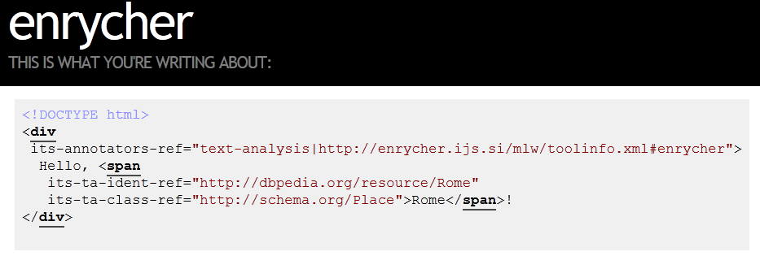
Creating translation context with disambiguation
Problem: Localizing content containing proper names without sufficient context
Solution: use natural language processing techniques to provide context for ambiguous content.
ITS 2.0 markup provides the key information about which entities are mentioned, so they can be correctly processed within translation
Data category: Text Analysis
Implemented and demonstrated with the Enrycher NLP tool
Demo: enrycher.ijs.si/mlw/
Questions: tadej.stajner@ijs.si
Notes:
JSI has provided major input to the ITS 2.0 data category “text analysis”. This data category provides key information about which entities are mentioned within content, so they can be correctly processed within translation. JSI also has developed a demo service that generates “text analysis” information for English and Slovene. This implementation and the “text analysis” data category achieved a lot of interest at this year’s Localization World conference. The reason is that they contribute to solving a common problem: providing the translators (humans or machines) with context.

Slide 11
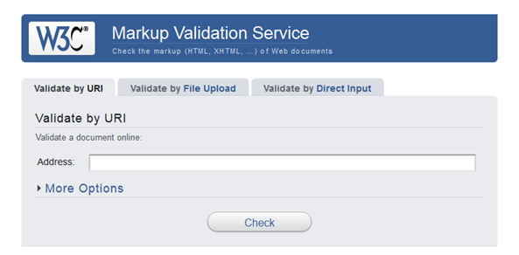
ITS 2.0 Support in Modern Document Formats
HTML5 support
  Native support (its-* attributes)
  Supported by validators – validator.w3.org and validator.nu
  You can use ITS markup right now in your pages and get them validated
DocBook support
  Supported by
  standard schema
  and stylesheets
DITA support
  Coming soon

Slide 12
(Automatically) process
ITS 2.0 enhanced content (1/2)
Machine translation statistical: Dublin City University. Presenter: Felix Sasaki
Machine translation rule based: Lucy Software. See presentation from Pedro Díez Orzas later
Building localization processes: ENLASO. Presenter: Felix Sasaki
Workflow for creating global content: Trinity College Dublin. Presenter: Dave Lewis
Building localization Web services: University of Limerick, Moravia. Presenter: David Filip
Preview in the browser: Logrus. Presenter: Serge Gladkoff

Slide 13



ITS 2.0 & Machine Translation
Translation Web Service
Training Web Service
Translating of HTML / XLIFF documents tagged with ITS 2.0 metadata
  Domain, Lang Info, Locale Filter
  Terminology, Translate
  MT Confidence, Provenance
Demonstrate pre/post process wrapper scripts are sufficient to adapt a pre-existing MT system to the ITS 2.0 standard
Benefits include integration of MT system into the larger localization pipeline
Use of metadata info to train Statistical MT components (Translation & Lang Models)
  Translate, Terminology
Extract do-not-translate and named entity Terms, force feed this in training cycle
  Significant Improvement observed in translation accuracy
Benefits include added consistency in translation across multiple documents
Web Service Located at: http://srv-cngl.computing.dcu.ie/mlwlt/
Notes:
DCU implemented ITS 2.0 in the MaTrex system: a statistical MT system based on the well-known Moses. A web service allows to access MaTrex and to translate HTML or XLIFF documents, processing ITS 2.0 information about the topic are (“Domain”), Terminology, and many other ITS 2.0 data categories. This implementation serves as a proof of concept that pre/post process wrapper scripts are sufficient to adapt a pre-existing MT system to the ITS 2.0 standard, and in this way ITS 2.0 can be integrated into a larger MT pipeline.
DCU also implemented a training Web service: ITS 2.0 metadata provides info to train statistical MT components. Especially relevant were “Translate” and “Terminology” information. Significant improvement was observed in translation accuracy. Benefits include added consistency in translation across multiple documents.

Slide 14


ITS in the Okapi Framework
Open-source and cross-platform set of libraries and tools for building localization processes.
Offers ITS support for XML, HTML5 and XLIFF, as well as in many components: Quality Check, Term Extraction, Microsoft Batch Translation, Enrycher, LanguageTool, etc.
Makes adoption of ITS easy for developers and immediate for Okapi’s tools users.
Continuing work after
the MLW-LT project.
Notes:
Okapi is an open-source and cross-platform set of libraries and tools for building localization processes. It offers ITS support for XML, HTML5 and XLIFF. All ITS 2.0 data categories can be parsed with Okapi. In addition Okapi provides many components for applying ITS 2.0, like Quality Check, extraction of terminology, an ITS 2.0 aware call of the Microsoft Batch Translation service, application of the forehand mentioned Enrycher tool etc. This makes adoption of ITS easy for developers and immediate for Okapi’s tools users. Finally ENLASO has been a long term key contributor to ITS 1.0 and 2.0 and is devoted to further work after the MLW-LT project.

Slide 15
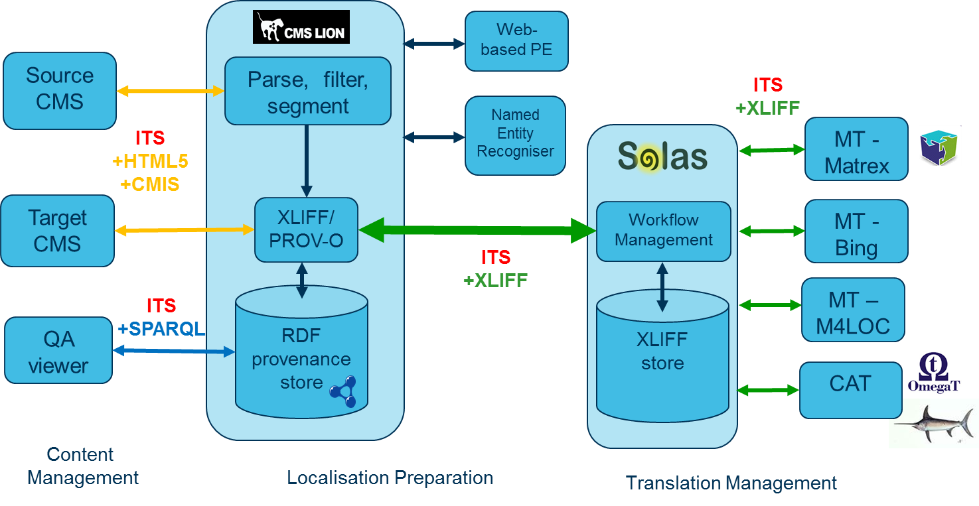
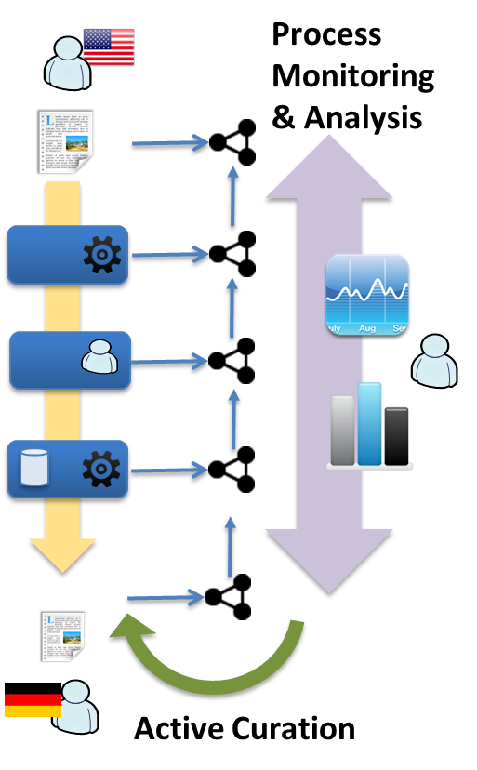

ITS2.0 for Global Intelligent Content
Multilingual Content Interoperability
Linked Data and Multilingual Content Processing
New FP7: FALCON
www.falcon-project.eu
New FP7: LIDER
www.lider-project.eu

Slide 16
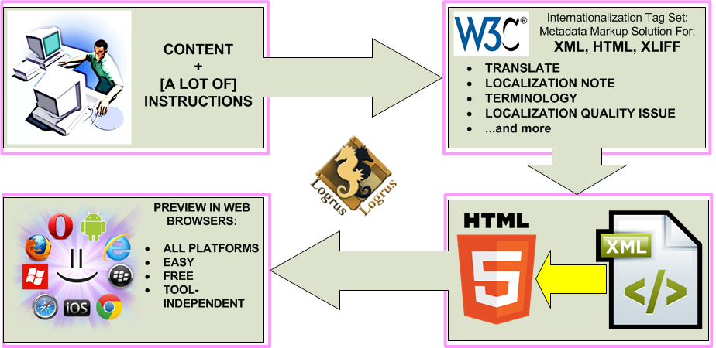
Preview of ITS 2.0 Metadata in Web Browsers
(Part of the Multilingual Web-LT Program)
COMPLEX METADATA AT YOUR FINGERTIPS:
Part of Work in Context Solution (WICS) from Logrus

Slide 17
(Automatically) process
ITS 2.0 enhanced content (2/2)
Capturing ITS 2.0 metadata: VistaTEC. Presenter: Phil Ritchie, separate slot
Localization CMS / TMS / MT integration: Linguaserve. Presenter: Pedro Díez Orzas, separate slot

Slide 18
What will or may come next?

Slide 19
What will or may come next?
Standardization break – let’s use the stuff and gather experience!
Contributions to the development of multilingual services and data analytics technologies
  “Terminology-Translation-Web technology” triangle
  Bridge to the Semantic Web: deploy ITS2<>NIF conversion (cf. Sebastian Hellmann poster), FALCON & LIDER projects
More deployment scenarios involving ordinary Web (content) developers – “ITS 2.0 for everybody”

Slide 20
Implementation
Basket
Moderator:
Felix Sasaki (DFKI / W3C Fellow)
Notes:
As said before, you will see many people on stage in this session. They will present you a “basket full of ITS 2.0 implementations”. Their work has been extremely fruitful. The picture on this slide will set you in the right mood to taste the delicious outcome of the work.

