Slide 1


Business Benefits of ITS 2.0-Aware Interoperability CMS-TMS and
Online Multilingual Publishing System
Pedro L. Díez Orzas

Slide 2

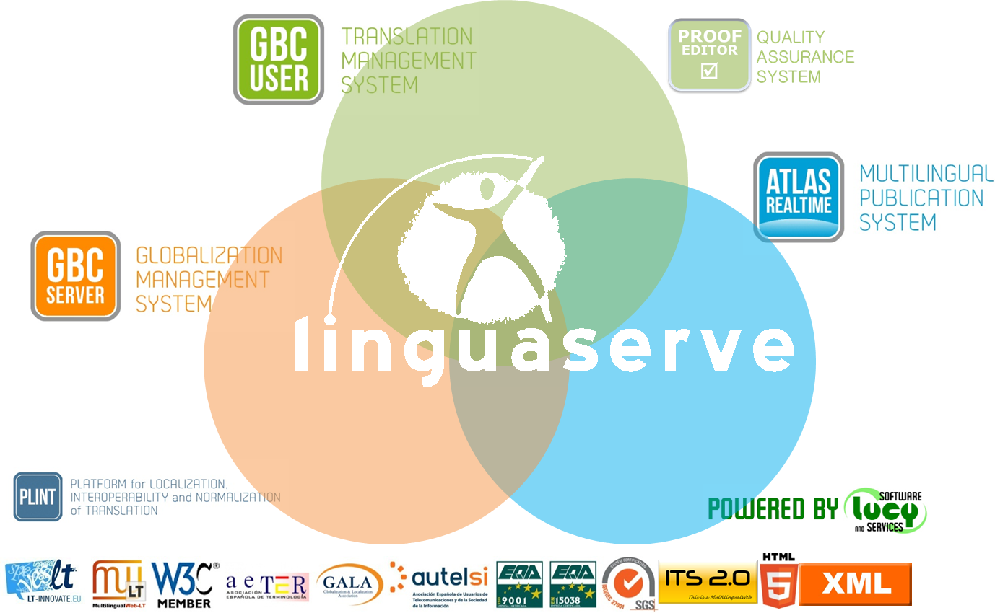
Linguaserve specializes in multilingual web advanced solutions for 21st Century Challenges.
Experience in interoperability since 2002
and real time multilingual web publishing
since 2008.
www.linguaserve.com

Slide 3

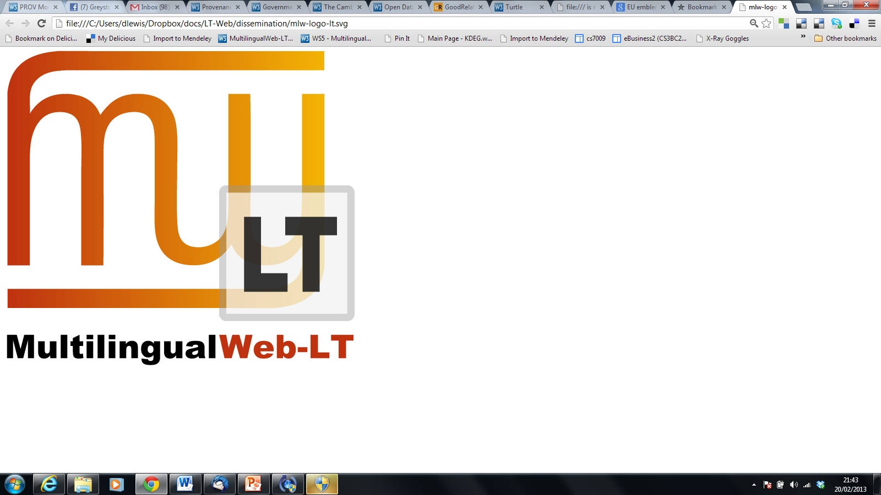


MLW-LT and ITS 2.0
Linguaserve is a member of MultilingualWeb-LT.

Slide 4
ITS 2.0-Aware Interoperability CMS-TMS
ITS 2.0-Aware Online Multilingual Publishing System
Horizons
Notes:
PORTADA

Slide 5

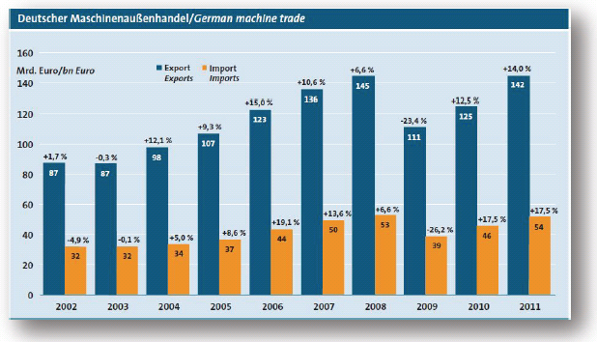
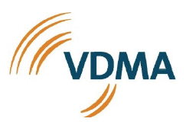
Use case: VDMA
ITS 2.0 Interoperability CMS-TMS
VDMA: German machinery and plant manufacturers' association
Largest industrial association in the capital goods industry in Europe (3170 industrial members)
Highly export-oriented

Slide 6
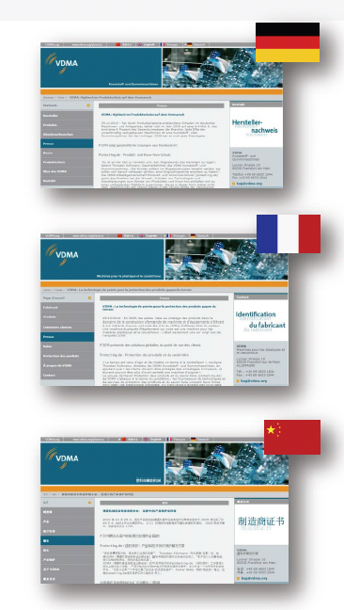
Use case: Scope
ITS 2.0 Interoperability CMS-TMS
Annotated, processed and translated 150 press releases
75,000 words annotated and processed with ITS 2.0
Using Drupal MLW-LT modules
ITS 2.0-aware automatic content round tripping
Languages: DE > FR, ZH

Slide 7
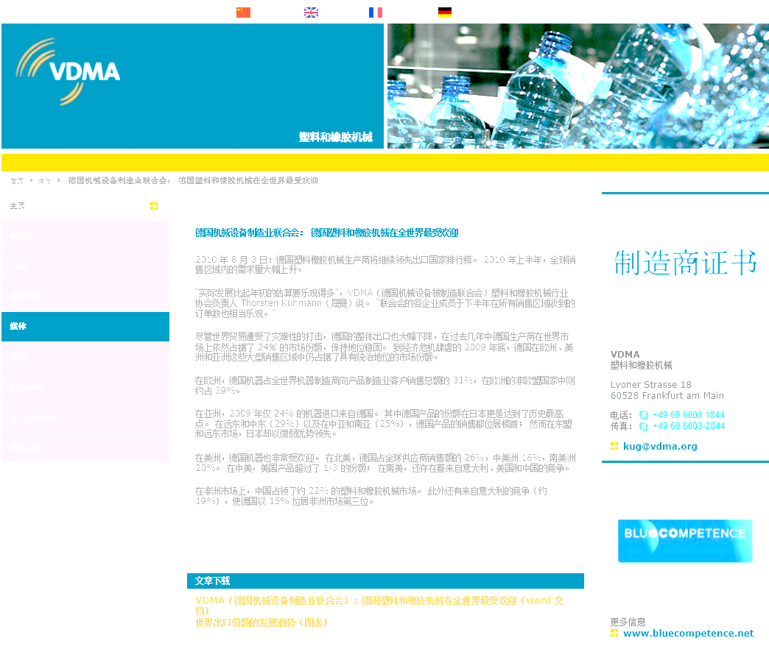
Use case, access and information
ITS 2.0 Interoperability CMS-TMS
http://www.w3.org/International/its/wiki
/ITS_Implementations
#CMS_Integration
http://www.w3.org/International/multilingualweb/lt/wiki
/Deliverables
D3.1.1. - D3.1.5. - D3.2.2 - D.3.23
Notes:
User: mlw-lt
Password: its2-wp4

Slide 8





High level flow
ITS 2.0 Interoperability CMS-TMS
WEB SITE
CMS
Webservices
TMS
Engine
(Processing)
Workflow
(Management)
CAT Tool / Machine Translation
www.vdma.org

Slide 9
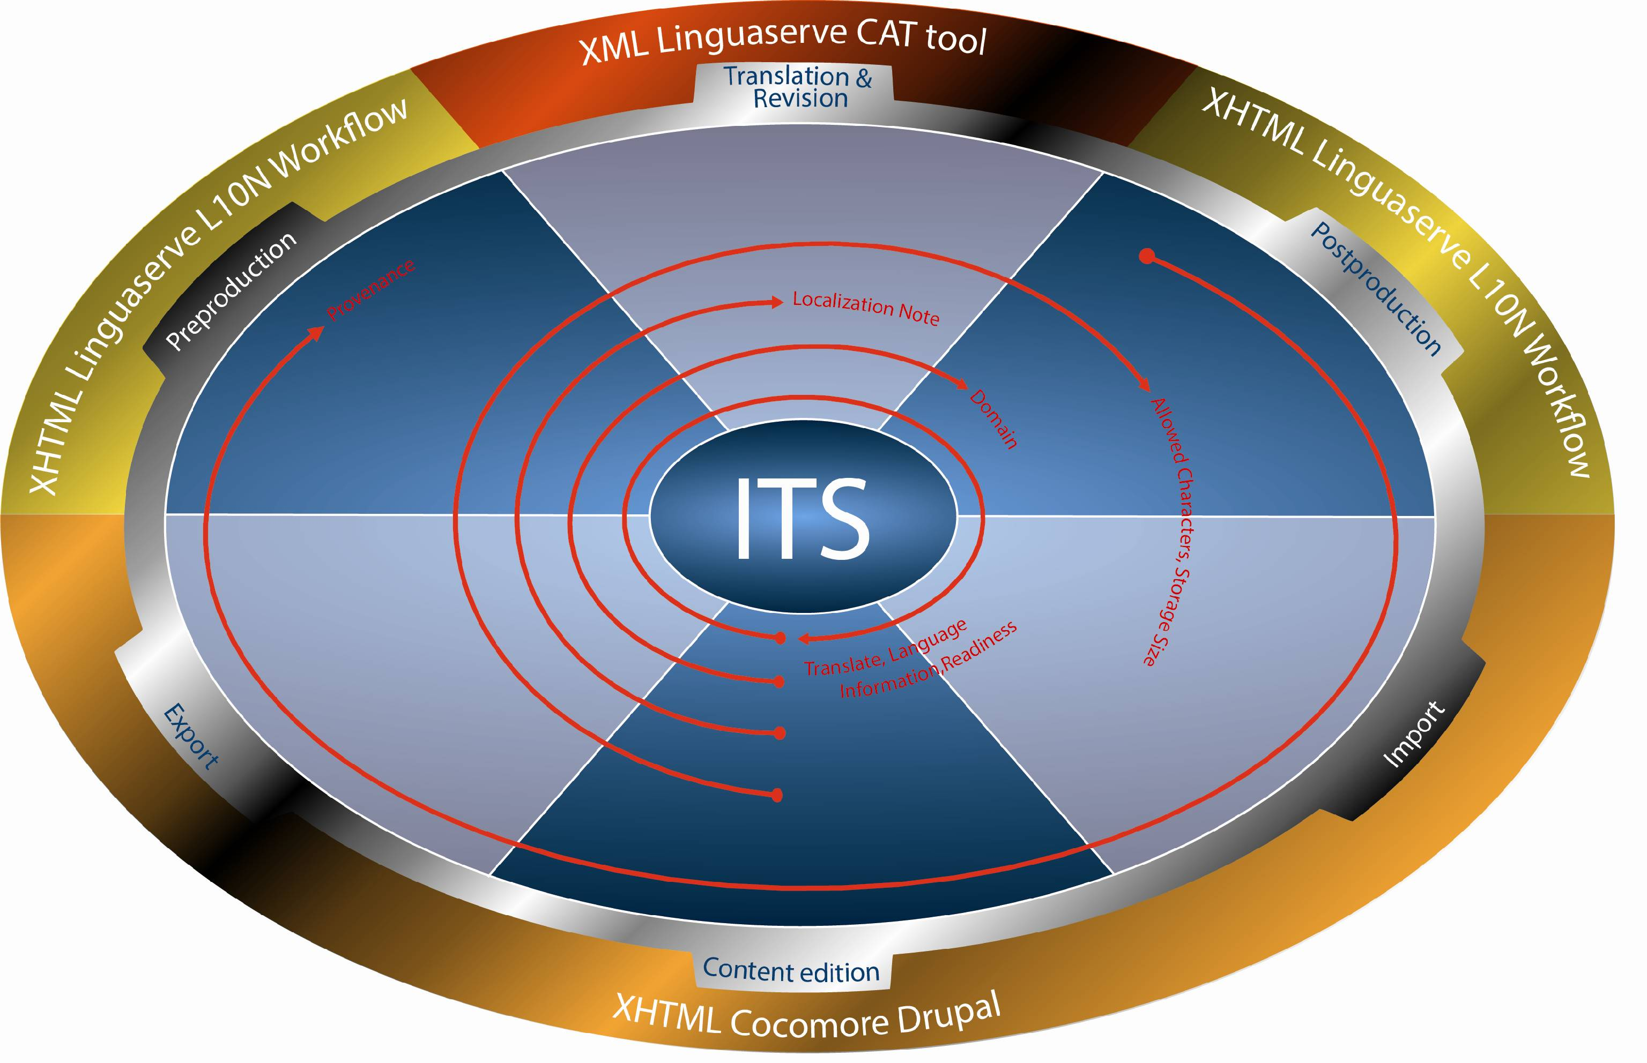
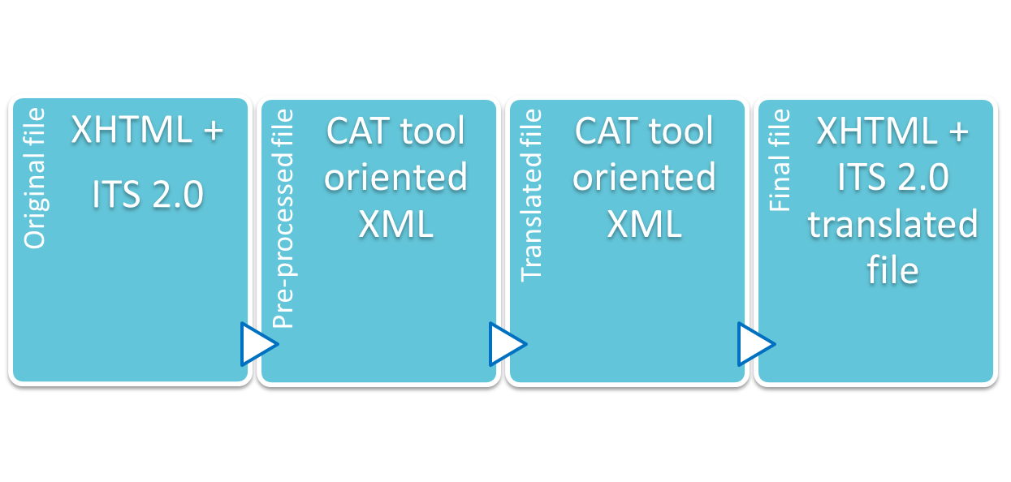
ITS 2.0 in CMS/TMS processing
ITS 2.0 Interoperability CMS-TMS

Slide 10
ITS 2.0 expectations
ITS 2.0 Interoperability CMS-TMS
Non-quality costs

Slide 11

Some ITS 2.0 benefits (I)
ITS 2.0 Interoperability CMS-TMS
ITS 2.0 increases both user’s control and automatic decision processes, allowing more “intelligence“ in the systems involved:
  Translate: can be automatically or manually annotated. E.g. it allows not to add “non-translatable” terms in several specific glossaries or MT systems.
  Localization Note: direct communication with PM and translators. When alert type, it can be used for triggering certain processes in the Translation Workflow.
  Domain: automatic selection of CAT/MT terminology and dictionaries. Selection of Translation Memories by domains.

Slide 12
Some ITS 2.0 benefits (II)
ITS 2.0 Interoperability CMS-TMS
  Language Information: quality check to ensure the source language content is according to the Webservice parameter.
  Allowed Characters: quality check for the target content.
  Storage Size: quality check for both original content and the target content to be uploaded into the CMS. It can be used also for translators’ visual control.
  Provenance: possibility to reassign the same translator/reviewer in new versions of the same content and inform the PM. Tracking control in the CMS.
  Readiness (ITS 2.0 extension): control of processes to be done, date control for availability, delivery and priority.

Slide 13
MLW-LT CMS-TMS SWOT
ITS 2.0 Interoperability CMS-TMS
Strengths
Weaknesses
More efficient control over the content
Faster and more efficient communication between localization chain actors (e.g. fine-grain communication webmaster/ localization project manager)
Localization platforms and format Independent
Better linguistic technology interaction machine/machine
Better translation and localization interaction human/machine
There is no CMS-TMS interoperability standard
Readiness can simplify the web service standard

Slide 14
MLW-LT CMS-TMS SWOT
ITS 2.0 Interoperability CMS-TMS
Opportunities
Threats
Accelerating adoption of interoperability localization chains
Problem solving, quality and control improvement for those clients already using it
Increasing fully automatic processes and localization expert systems
Opens up ways for connectors, pre-editing, post-editing, cat tools, and Translation and Localization management systems
Source content annotation and tools
CMS developers adoption
ITS 2.0 compliant and facilities CAT/Post-editing tools
SEO applications
Automatic annotation
Content creators / webmasters adoption

Slide 15

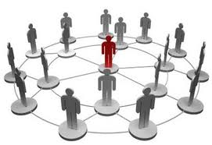
Business: Opportunities rise from needs
ITS 2.0 Interoperability CMS-TMS
Very frequently updated web sites that need efficient multilingual updates and maximum control:
  Corporate and industry information
  e-Government
  e-Commerce
  Educational web sites
Highly distributed content creation through the CMS
Web 2.0 and user content created
  Applying MT systems for immediacy
Using ITS 2.0 to contribute for multilingual SEO

Slide 16
ITS 2.0-Aware Interoperability CMS-TMS
ITS 2.0-Aware Online Multilingual Publishing System
Horizons
Notes:
PORTADA

Slide 17

Use case: the Spanish Tax Agency
ITS 2.0 Online Multilingual Publishing System
  www.agenciatributaria.es is the user in the “Online MT System” showcase in MLW-LT
Spain: General Indicators 2011
  Spain is a country that is regionally structured into 17 autonomous communities and 2 autonomous cities with 5 co-official languages
  Population : 47,190,493 inhabitants ( 12.2 % foreign residents)
Mission of the Spanish Tax Agency
  Effective application of Spain’s tax and custom system
  Management of tax resources on behalf of other public administrations when required by Law or Agreements
General taxpayer census
  Individual taxpayers: 46,509,231
  Companies: 2,674,547
  Other organisations: 2,293,939
Total taxpayers: 51,477,717
Notes:
PORTADA

Slide 18
Use case: Scope
ITS 2.0 Online Multilingual Publishing System
Online MT System Internationalization showcase components:
  ITS 2.0
  HTML5
  ATLAS RT (Linguaserve’s Real-time Multilingual Publishing System)
  Lucy Software MT (Rule-based Machine Translation)
  MaTrEx, from Dublin City University (Statistical Machine Translation)
  www.agenciatributaria.es (CMS: OpenText WEM)
RTMPS implementation and deployment in pre-production
  ITS 2.0 data categories: 6 (Translate, Localization Note, Language Information, Domain, Provenance, Localization Quality Issue)
  Prototypes, test suite engines, and use case
250 web pages ES-EN and 30 web pages ES-FR, ES-DE
  Content annotation and MT post-editing (EDI-TA methodology)
Notes:
Seventh Framework Programme (FP7)

Slide 19
Spanish Tax Agency Showcase
ITS 2.0 Online Multilingual Publishing System
Pre-production (http://its2demo.aeat.es/)
  Spanish:
  http://its2demo.aeat.es/AEAT.internet/Inicio.shtml
  English: http://its2demo.aeat.es/AEAT.internet/en_gb/Inicio.shtml
  French: http://its2demo.aeat.es/AEAT.internet/fr_fr/Inicio.shtml
  German: http://its2demo.aeat.es/AEAT.internet/de_de/Inicio.shtml

Slide 20
Use case, access and information
ITS 2.0 Online Multilingual Publishing System
http://www.w3.org/International/its/wiki
/ITS_Implementations
#Real_Time_Multilingual_Publishing
http://www.w3.org/International/multilingualweb/lt/wiki
/Deliverables
D4.1.x
D4-2x
Notes:
User: mlw-lt
Password: its2-wp4

Slide 21
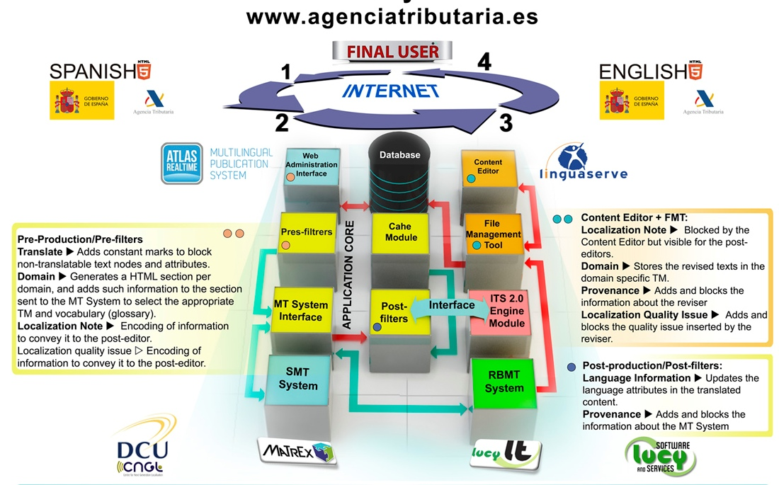
Online MT System I18N
ITS 2.0 Online Multilingual Publishing System

Slide 22
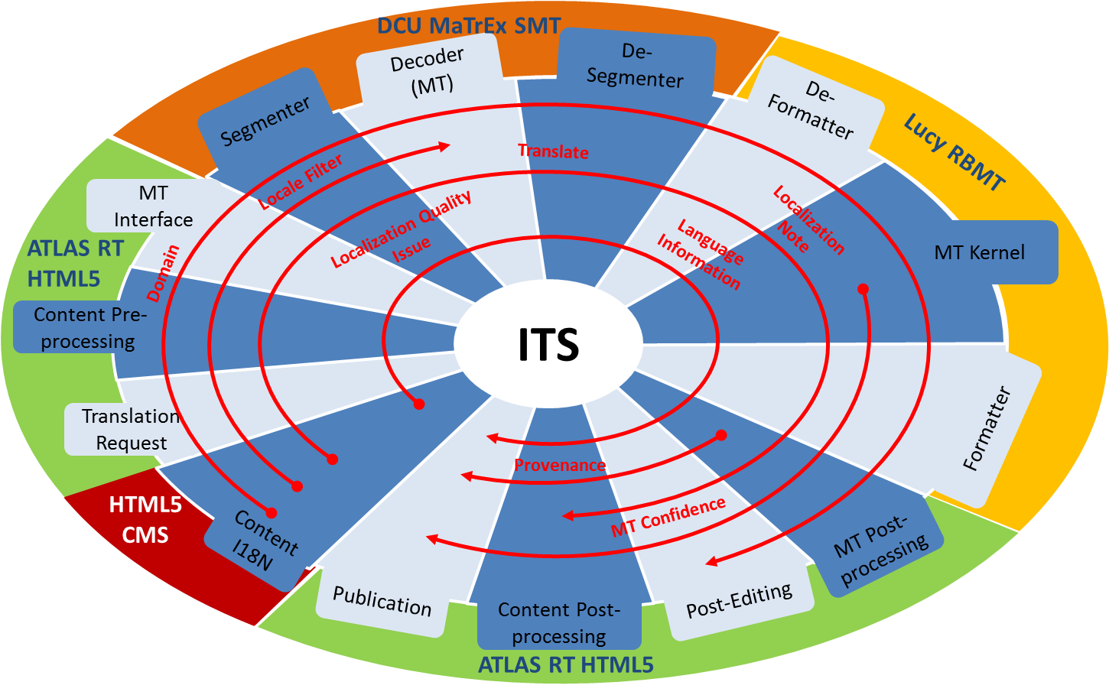
ITS 2.0 in Online MT System I18N
ITS 2.0 Online Multilingual Publishing System

Slide 23
Shifting to HTML5: Strategy
ITS 2.0 Online Multilingual Publishing System
Using ITS 2.0 requires HTML version 5 according to the current W3C specification.
HTML5
Analysis of existing website
Shallow HTML5
Automatic conversion
Deep HTML5
Content creation
Impact and implications
Schedule and content selection
New content and functionalities
Notes:
PORTADA

Slide 24
ITS2.0 annotation experience
ITS 2.0 Online Multilingual Publishing System
Strategy adopted in order to annotate the content with ITS2.0 in an efficient and pragmatic way, considering the pressure and requirements of a real environment.
Automatic custom tags conversion
Automatic annotation
Manual annotation

Slide 25
ITS 2.0 immediate benefits
ITS 2.0 Online Multilingual Publishing System
ITS 2.0 increases user’s control and automatic decision processes:
  Translatability and language pair selection (Translate, Language information). It allows not to add “non-translatable” terms in specific glossaries or MT.
  Specific terminology to apply in the MT (Domain)
  Activation rules for MT post-editing (Localization Note)
  Quality aspects reported to translation consumer or post-editor (Localization Quality Issue)
  Post-editors judge quality of translation (MT Confidence)
  Identification of agents (provenance)

Slide 26
Shifting gears: New cost structure
ITS 2.0 Online Multilingual Publishing System

Slide 27
MLW-LT Online MT Business Case
ITS 2.0 Online Multilingual Publishing System
Strengths
Weaknesses
Lower translation costs (MT + PE) depending on % of post-editing (E.g. 100% post-edited: - 30%)
Management costs: higher setup / lower maintenance (-60%-80%)
Non-invasive technology
Real-time or fast post-edition
  Viability dependent on :
  Language combination and MT system output
Recent MT approaches (Hybrids, vertical sectors/users…)
Opportunities
Threats
  Web sites with daily high volume updates: Ecommerce, Administration, Corporate news and publications, user content generated (social media)
In house installation for sites > 1 million words and frequently updated
Control, performance and security:
Real-time performance of MTs
Security level in shared RTMPS
Needs pre-editing and post-editing tools (ITS 2.0 and HTML5 compliance)
The client might lose control of the translation: solved with ITS 2.0

Slide 28

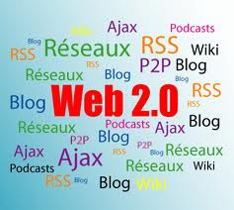
Business: Opportunities rise from needs
ITS 2.0 Online Multilingual Publishing System
e-Commerce
  Very high volume and rotation
  Short texts and repetitive descriptions
    Better for MT
    Quicker to post-edit
  Very sensitive to ITS 2.0 benefits
e-Government
  Controlled language and content policies
HTML from several CMS and other applications (Content source independent)
Web 2.0 and user content created
  GIST translation
  Immediacy

Slide 29
ITS 2.0-Aware Interoperability CMS-TMS
ITS 2.0-Aware Online Multilingual Publishing System
Horizons
Notes:
PORTADA

Slide 30
Standards help both:
SMEs and large companies
Horizons
ITS 2.0 innovation opportunities:
  Automatic annotation and assisted tools
  Content Management Systems
  Web browsers
  Pre-editing, Linked Open Data and Enrycher systems and tools
  HTML publishing Systems
  Translation and Localization Expert Systems and workflows
  Translation Management and Business Systems
  Machine Translation
  Machine Translation Post-editing Tools
  Computer Assisted Translation tools
key multilingual web applications
Notes:
for many

Slide 31
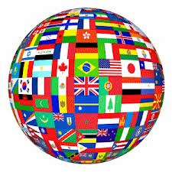
The Multilingual Web Server
Horizons
ITS 2.0 improves a full equipped multilingual web server:
  Interoperable Web Services
  Real-time multilingual publishing and translation
  Expert Translation and Localization Management Systems
  Collaborative solutions between hybrid MT and human translation
  Linked Open Data compliant
  Pre and Post-editing, lexical, terminological, CAT Tools
  Translation Cloud
  Automated Quality Assurance
  Operational and management virtual offices and interfaces
Notes:
for many

Slide 32
Thank you. pedro.diez@linguaserve.com

