Slide 1
Everything you wanted to know about the Internationalization Tag Set - ITS2.0
Dave Lewis
W3C MultilingualWeb - Language Technology Working Group
CNGL
Trinity College Dublin

Slide 2
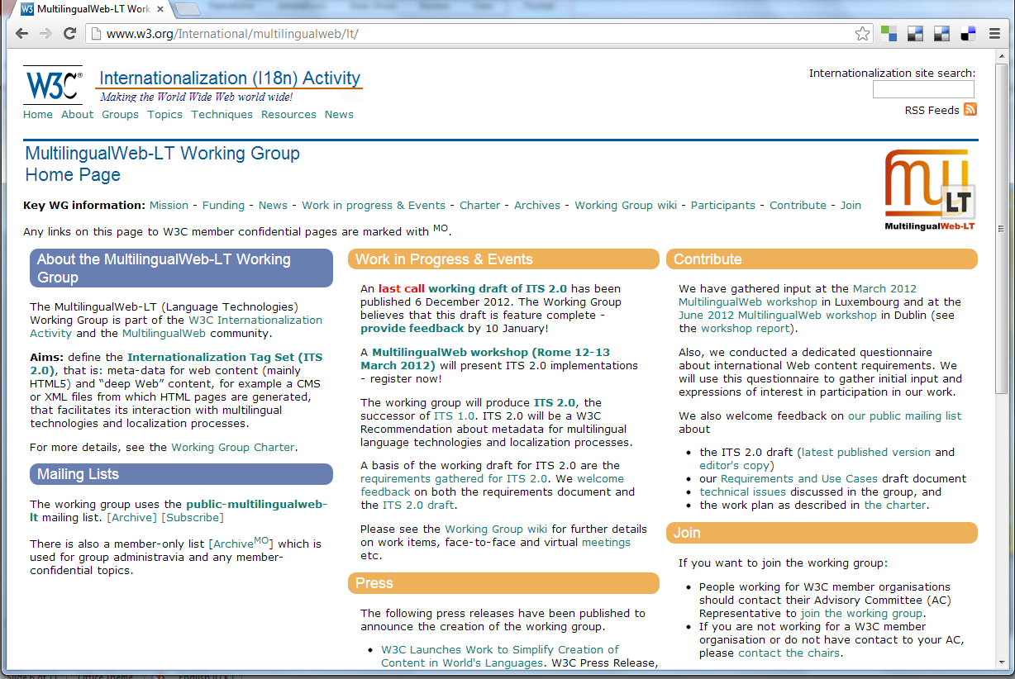

Slide 3
What is ITS 2.0?
Meta-data annotations addressing gaps in I18n and L10n interoperability
CMS, L10n Tools, Language Technology
Defines 19 separate Data Categories
Defines implementation in HTML5, XML and RDF

Slide 4
ITS2.0 Summary
41 WG Members
Test Suite: 225 File
3500+ list posts
9 Face-to-Face WG meeting
57 online WG meetings
894 successful conformance test
9 Implementations

Slide 5
Use Cases
Content Management
Terminology
Translation
Quality Assurance
Workflow / Resource Management
ITS2.0

Slide 6
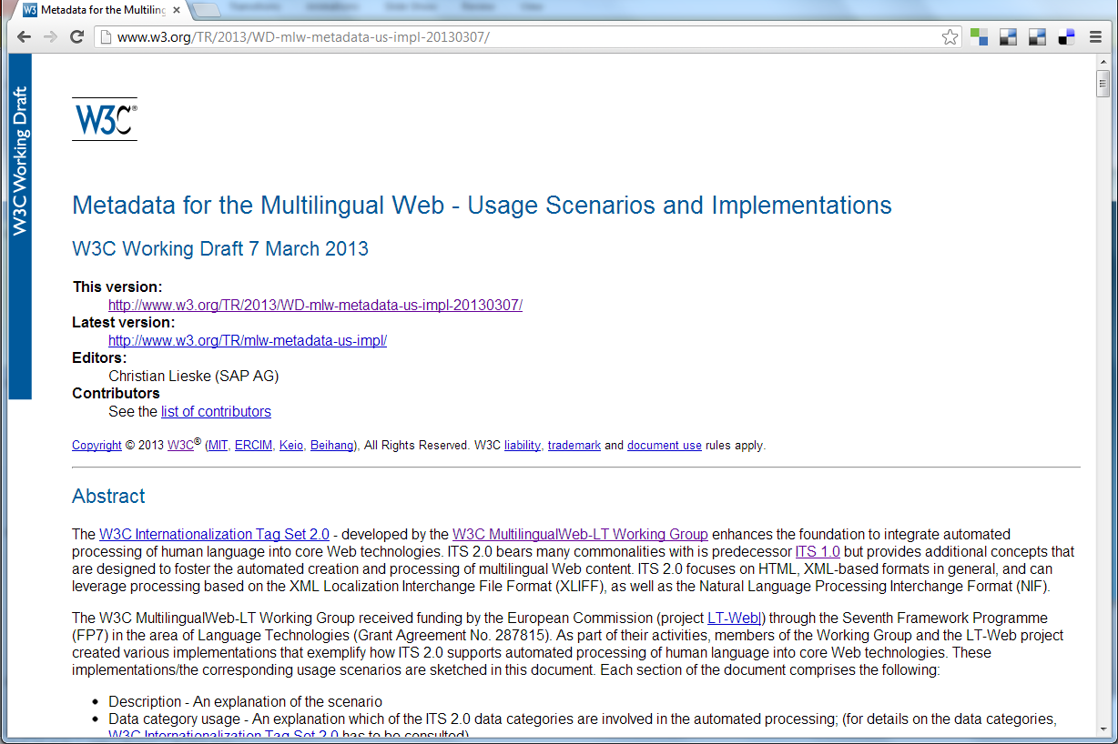

Slide 7
Content Management

Slide 8
CMS-based I18n
Content Management

Slide 9
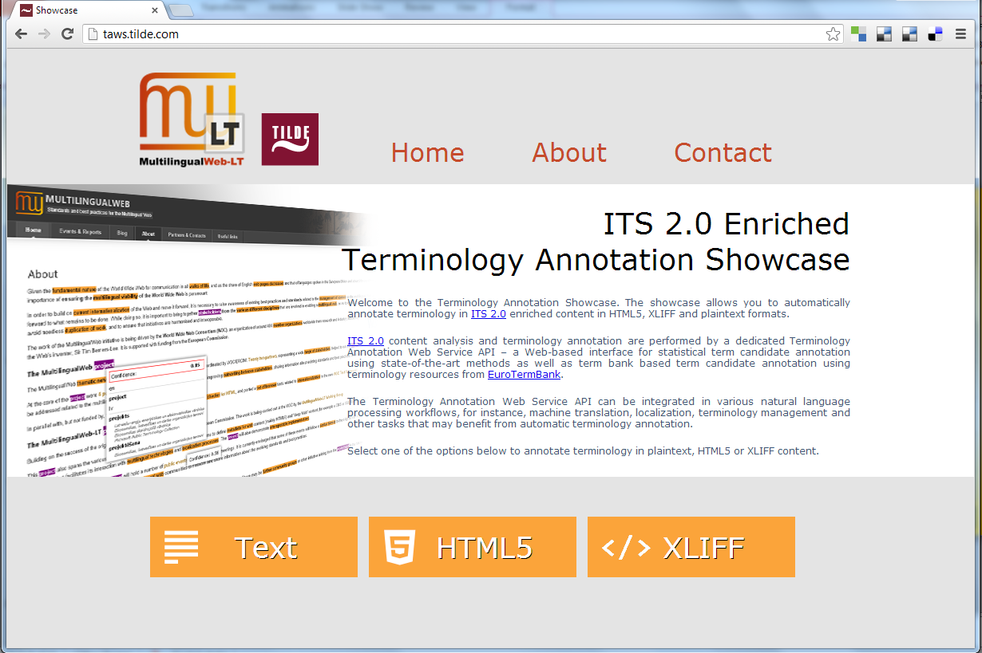
Terminology
Terminology

Slide 10
Text Analytics
Terminology

Slide 11
Spanish Tax Agency
Translation

Slide 12
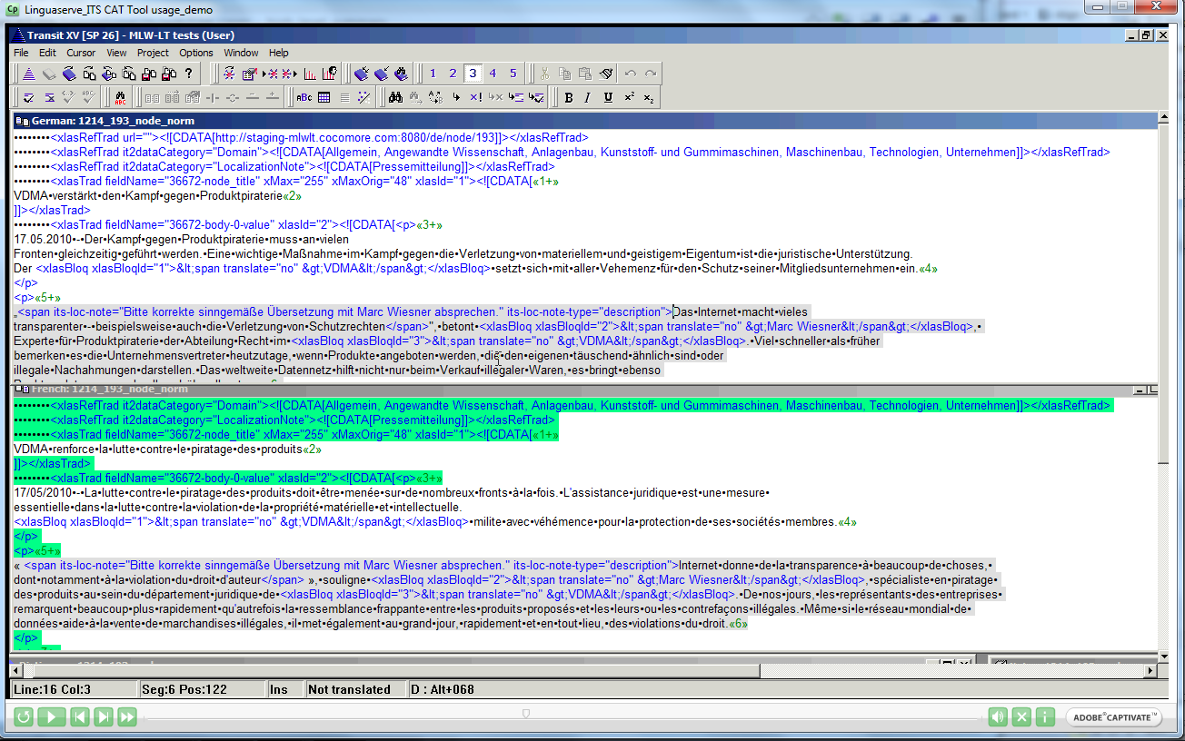
Translation

Slide 13
Spanish Tax Agency: QA Example
Quality Assurance

Slide 14
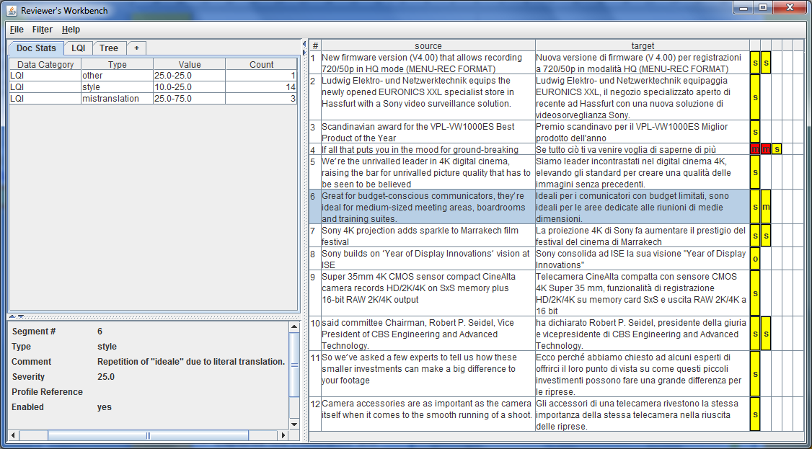
QA: Reviewers Benchmark
Quality Assurance

Slide 15
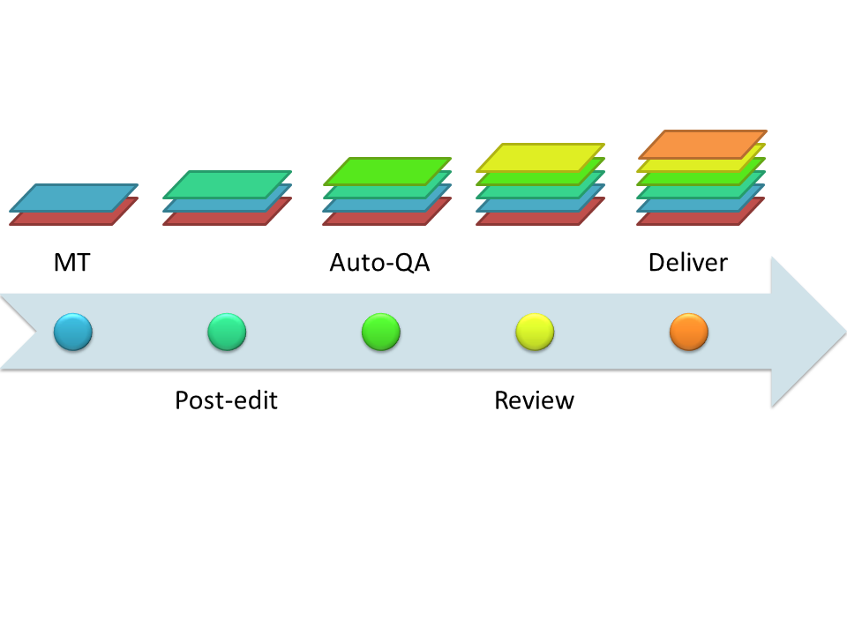
Workflow/Resource Management
Workflow / Resource Management
Better up-front and real-time business decision support:
Use historic and aggregated metadata for inference
Content carries its own “audit trail”
Metadata can be transformed to linked semantic data allowing:
Inferential queries across data siloes
New forms of data visualization
Extensible data relationships

Slide 16
ITS2.0 Summary
Spec in W3C ‘Last Call’
W3C Recommendation by Autumn
Tools and Best Practice @ ITS Interest Group
ITS-XLIFF – Liaison with OASIS TC
ITS-RDF:NIF, PROV-O – W3C Community Group
ITS-CMIS – contribution to open CMS-TMS
Editors and CAT tools

Slide 17
Questions?

