Slide 1
Text Analytics in ITS 2.0: Annotation of Named Entities
Tadej Štajner
Jožef Stefan Institute

Slide 2
Motivation
Translating proper names
… can be problematic for statistical MT systems

Slide 3
Text Analysis in ITS 2.0 – what can it tell us?
Does a fragment of text represent a particular object?
London is lovely in the summer.
Out of 73 known entities named London, we mean a particular one: http://dbpedia.org/resource/London
Does a fragment of text represent a particular type of object?
London is a phrase, representing a location

Slide 4
Motivation (2)
Translation depends on source and target language:
There are specific rules to translate (or transliterate) particular proper names or concepts
Sometimes, they should not even be translated
Solution: figure out what is actually being mentioned and see if any existing translated expression exists for that entity

Slide 5
Motivation (3)
Localization of proper names:
personal names, product names, or geographic names, chemical compounds, protein names
Names and phrases can appear in situations without sufficient context (UI labels, etc.):
we can use ITS2.0 Text Analysis annotations to provide context for ambiguous content.

Slide 6
ITS2.0 Text Analysis
Support text analysis agents that enhance content by suggesting or identifying concepts, identities, identified by IRIs.
The data category provides three pieces of information:
confidence
entity type/concept class
entity/concept identifier

Slide 7
ITS2.0 Text Analysis
<!DOCTYPE html>
<div
its-annotators-ref="text-analysis|http://enrycher.ijs.si/mlw/toolinfo.xml#enrycher">
<span
its-ta-ident-ref="http://dbpedia.org/resource/Dublin"
its-ta-class-ref="http://schema.org/Place">Dublin</span> is the <span
its-ta-ident-ref="http://purl.org/vocabularies/princeton/wn30/synset-capital-noun-3.rdf">capital</span> of <span
its-ta-ident-ref="http://dbpedia.org/resource/Ireland"
its-ta-class-ref="http://schema.org/Place">Ireland</span>.
</div>

Slide 8
Producing these annotations
NLP Techniques
Named entity extraction & disambiguation
Word sense disambiguation
Manual annotation

Slide 9
Use cases
Informing a human agent (i.e. translator) that a certain fragment of text is subject to follow specific translation rules:
proper names
officially regulated translations.
Informing a software agent (i.e. CMS) about the conceptual type of a textual entity in order to enable special processing or indexing

Slide 10
Named entity disambiguation
Document
Entity
Label
Mention

Slide 11
Named entity disambiguation – behind the scenes
A difficult problem:
A name can refer to many entities, an entity can have many names
Which interpretation is correct?
Humans are pretty good at this
We have prior knowledge on the ‘usual’ meanings
We can glean the meaning from the context
Things which are related appear together

Slide 12
Named entity disambiguation – behind the scenes (2)
Text analysis heuristic mimic the human:
Prior knowledge: get lots of training data, and learn a probabilistic model (what is the most frequent meaning of ‘London’)?
Context: does the surrounding text of the mentioned name use similar vocabulary than the context of the entity? (someone using the word ‘London’ in the context of ‘Canada’ is likely to be referring to another London in Ontario)

Slide 13
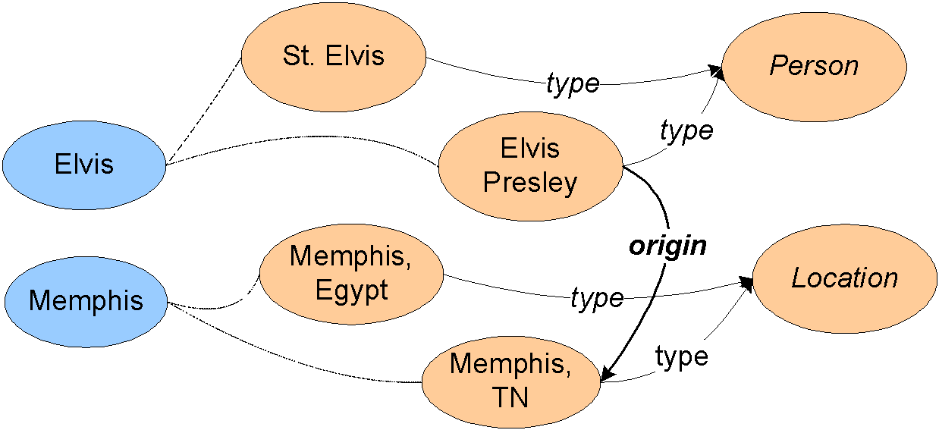
Named entity disambiguation – behind the scenes (3)
Relational similarity: when disambiguation, take a look at the background knowledge graph and consider those connections: (things that are connected in the graph tend to appear together)

Slide 14
Building blocks of Enrycher
Token-level analysis
Sentence splitting
Tokenization
Lemmatization
Part-of-speech tagging
Entity-level analysis
Named entity extraction
Co-reference resolution
Anaphora resolution
Named entity disambiguation
Document-level analysis
Sentiment analysis
Topic classification
Keyword extraction
(not used here)
Token-level analysis
Sentence splitting
Tokenization
Lemmatization
Part-of-speech tagging

Slide 15
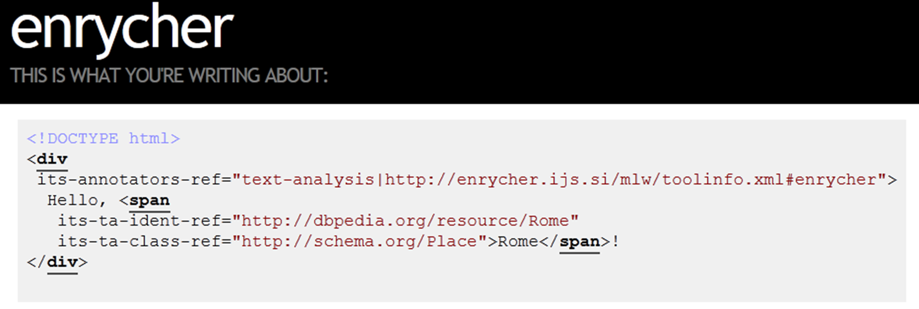
Demo
http://enycher.ijs.si/mlw/
Source code: https://github.com/tadejs/enrycher-its20

Slide 16
Using Enrycher
A HTTP service endpoint: send HTML5 in, get enriched HTML5+ITS2.0 out
Multilingual: supports English and Slovene
$ curl -d "<p>Welcome to London</p>" http://enrycher.ijs.si/mlw/en/entityIdent.html5its2
<p>Welcome to <span
its-ta-ident-ref="http://dbpedia.org/resource/London"
its-ta-class-ref="http://schema.org/Place">London</span></p>

