Slide 1
Multilingualism on the Internet: Putting the World in the World-Wide Web
Arle Lommel
Deutsches Forschungszentrum für Künstliche Intelligenz (DFKI)

Slide 2
Some Background

Slide 3
The Vision of the World Wide Web
This works at the data level: you can access the Internet from (almost) anywhere in the world

Slide 4
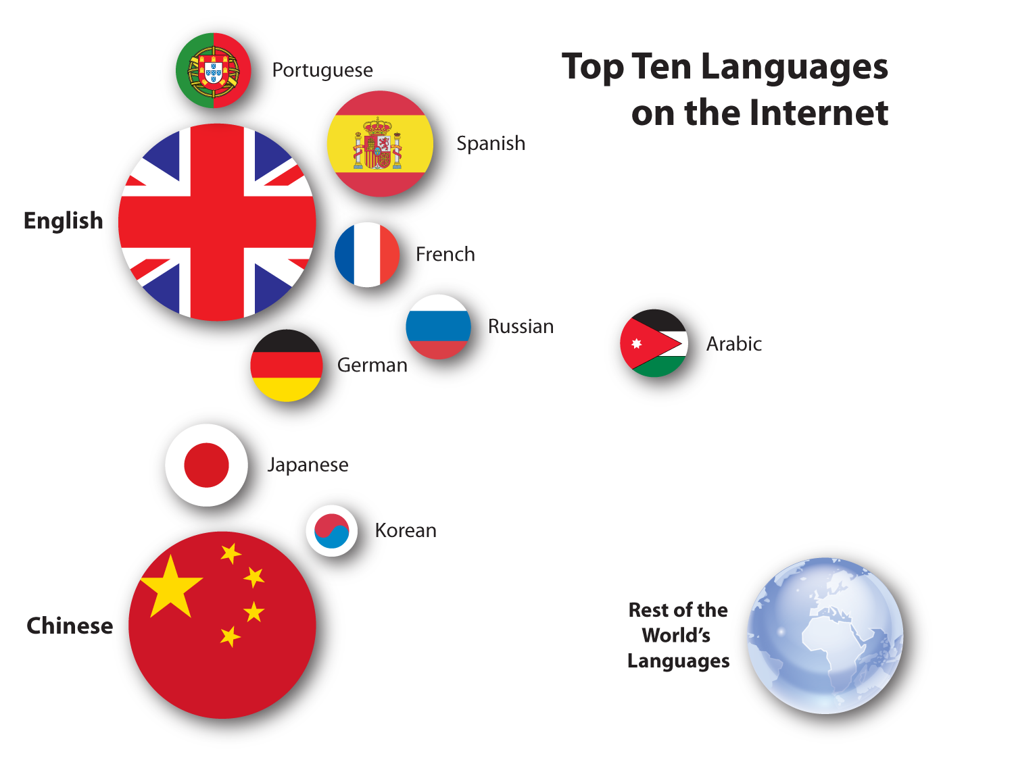
The Reality: Multiple Webs
Based on http://www.internetworldstats.com/stats7.htm

Slide 5
Change
Since 2000:
Chinese grew ~1500%
Arabic grew ~2500%
Russian grew ~1800%
Top ten languages grew 421%
Rest of the world grew 589%
Based on http://www.internetworldstats.com/stats7.htm

Slide 6
Alexa Rankings in Germany
Google.de
Facebook.com
Google.com
Youtube.com
Ebay.de
Amazon.de
Wikipedia.org
Spiegel.de
Bild.de
Yahoo.com

Slide 7
Alexa Rankings in China
Baidu.com
QQ.com
Taovao.com
Sina.com.cn
Google.com.hk
163.com
Weibo.com
Sohu.com
Google.com
Ifeng.com

Slide 8
Why the Difference?
Culture: Different sites are adapted to different cultures
Language: You can’t access what you can’t read

Slide 9
Culture
Difference is good…
You can (usually) deal with cultural difference
It enriches our experience
Great if we could access Chinese sites to learn…

Slide 10
Language is the Key Issue
Language both enables and prevents cultural contact
Solutions?
We all learn the same language
We all learn every language
Translation

Slide 11
Two Translation Approaches
Push: The content creator supplies the translation: E.g., translation company does the work
Pull: The content consumer gets the translation: E.g., Google Translate

Slide 12
Why Not Human Translation for Everything?
Expensive (€0,25/word is common): a 5000-word document can cost €1.250 for one language
Not enough translators
Not suitable for on-demand needs
Not all languages are available

Slide 13
Why Not Google Translate for Everything?
Quality is a major issue
Lack of integration: not easy to access
No social interaction
Relies on human translation

Slide 14
Intelligence Creates Quality
To fix quality (for humans or machines), you need intelligence…
Intelligence allows you to deduce things you would not otherwise be able to understand
Should “Different Types of Windows Are Very Useful” be?
Verschiedene Arten von Windows sind sehr nützlich
Verschiedene Arten von Fenster sind sehr nützlich

Slide 15
Humans Are…
Very good at:
deduction
dealing with (implicit) context
adding intelligence
dealing with exceptions
Very bad at:
doing things quickly
doing the same thing over and over

Slide 16
Machines Are…
Very good at:
doing things quickly
doing the same thing over and over
Very bad at:
deduction
dealing with (implicit) context
adding intelligence
dealing with exceptions

Slide 17
If Machines Cannot Add Intelligence…
Then we need to make data intelligent
Apply what humans do well to enable machines to do what they do well

Slide 18
Example
An alcoholic beverage slogan:
“Give the Gift of Mist”
Do we translate this or not?

Slide 19
Examples
The “translate” attribute (already in HTML5):
<p>He bought a <span translate=“no”>Super Soaker™</span> water gun at <span translate=“no”>Joe’s Toy Emporium</span></p>
“Domain”:
Windows = Windows (IT)
Windows = Fenster (Construction)

Slide 20
The MultilingualWeb-LT Project
Seeks to…
Supply metadata to support the translation of Web and “deep Web” content
Simplify translation (and lower costs)
Improve quality of translation through intelligent data
Create easy ways for content creators to improve their source text

Slide 21
The MultilingualWeb-LT Project
Administered through the World Wide Web Consortium
Funded by the European Commission
Run through the German Research Centre for Artificial Intelligence
Representatives of industry, research, academia
Focus on concrete deliverables

Slide 22
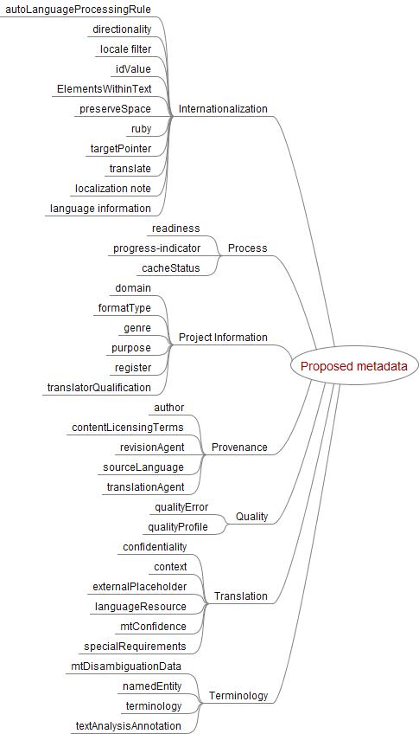
Proposed Scope

Slide 23
Intended Outcome
Lower barriers to information access
Lower cost of translation (for human translation)
Increase quality (for all translation)
Enable linking of data across languages (improve quality for all)

Slide 24
So What Do We Need?
Better dynamic translation tools: e.g., on on-line forums
Better quality
Easier access to translation
Planning for translation
Support

