Slide 1
Reviewer’s Workbench
(and post-editor’s)
^
Harnessing ITS Metadata to Improve the Human Review Process
Phil Ritchie, CTO, VistaTEC
Presented by Mel Howes, VistaTEC

Slide 2
Context
XLIFF
Identify Terms
Machine Translate
Text Analysis
Terminology
Text Analysis
Post Edit
Domain
Translate
Segment
ITS
Quality Check
Extract
MT Confidence
HTML5
CMIS
HTML5
CMIS
Localisation Quality Issue/Rating
PublishContent
Content I18N
Provenance
Curate Corpora
Workflow Analysis
RDF:
PROV NIF

Slide 3
Current Approach
Reviewer is often instructed on how much time to spend or amount of content to review.
This amounts to a random, human judgement on what to look at.
This amounts to a process which is statistically unlikely to discover errors.
Risk increases the larger the volume.
Notes:
Unguided review – see how much you can review in the time we can afford.

Slide 4
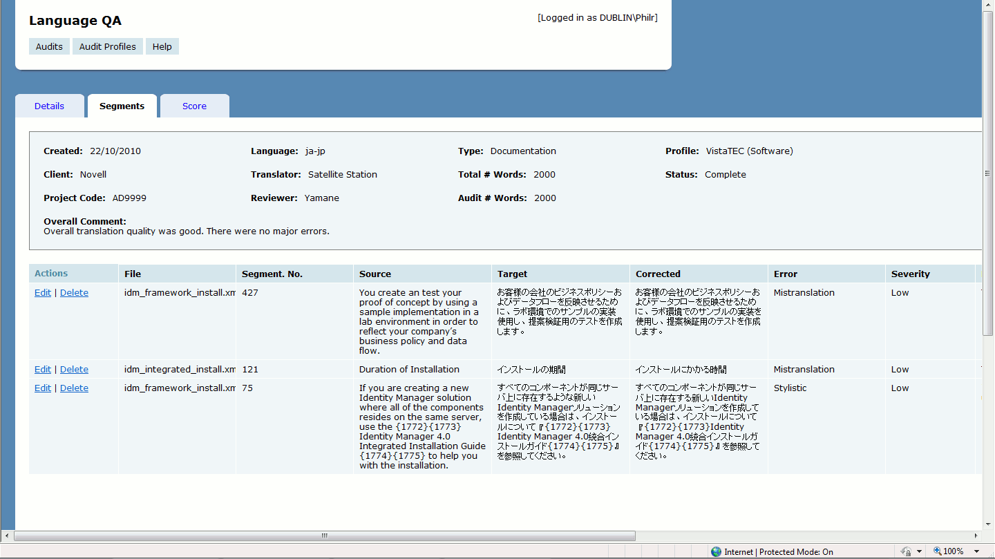
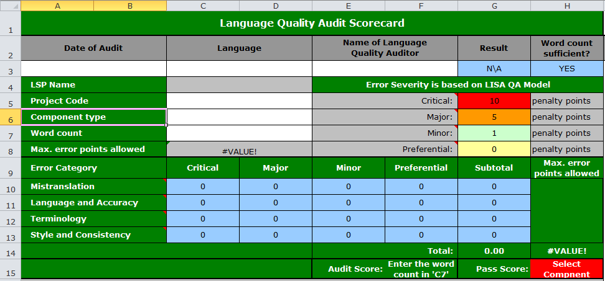
Current Practice
Notes:
Errors logged, often as copy and paste from review doc into system, or XLS. Very manual.
Scores aggregated to provide overall score for job.
Difficult to aggregate beyond single jobs.

Slide 5
Audit Trail
MT
Post-edit
Auto-QA
Review
Deliver
Notes:
Beauty of ITS 2.0 is that key data relating to provenance and quality can be embedded in the actual review files themselves.
At each stage in the process, additional layer of information can be added and retained.

Slide 6
Reviewer’s Workbench
Demonstration

Slide 7
Scenario
Translation
Text Classification
Review
Automated QA Check
Agent provenance available
Checkmate, QA Distiller or similar
Review Sentinel
Human review using Reviewer’s Workbench
Conversion to RDF
Linked Data queries
“Non-conformance” scores added
Business Intelligence
Trends to inform future approach
Provenance (human and automated agents)
Localization Quality Issue
Notes:
Suggested process.
At each stage it is clear “who” performed which tasks. Full audit trail.
Quality data from automated checks can be added.
Human reviewers can be focused on lower quality areas.
Data can be “mined” for intelligence.
Resource Description Framework (RDF) - is similar to classic conceptual modeling approaches such as entity–relationship or class diagrams, as it is based upon the idea of making statements about resources (in particular web resources) in the form of subject-predicate-object expressions. These expressions are known as triples in RDF terminology.

Slide 8
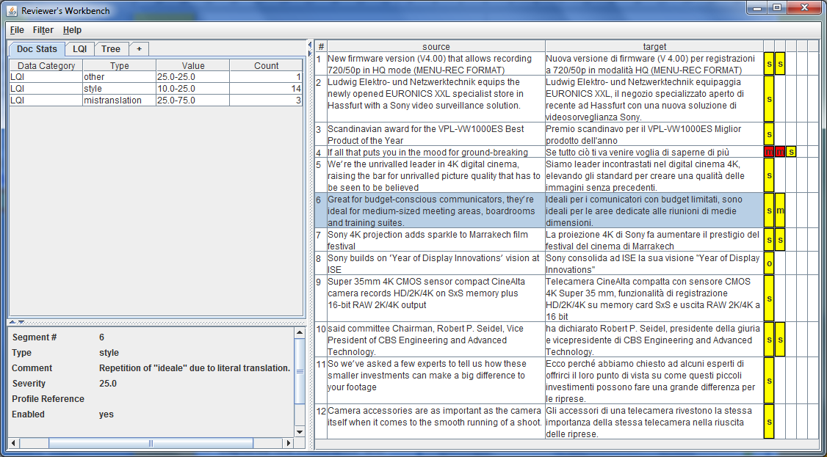
Reviewer’s Workbench

Slide 9
Business Value – Review Process
Review Process
Single reviewing environment
No double transcription of errors
“Informed” focus of attention
Greater efficiency
Full audit trail
Import into enterprise QA database possible

Slide 10
Business Value – BI and DS
Business Intelligence and Decision Support
Cross silo queries
Join metadata gathered by client at authoring stage with translation review metadata
Discover new relationships/correlations between source and target; agents
New forms of inferential queries and data visualisation
Better up-front and real-time business decision support

Slide 11
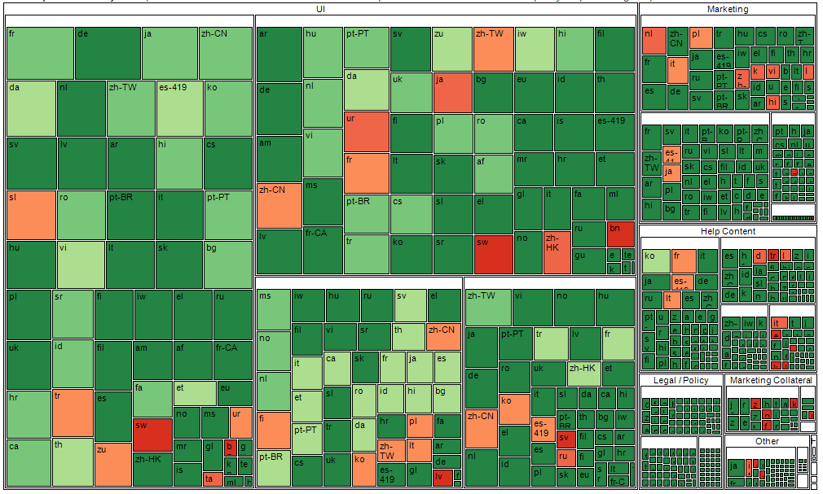
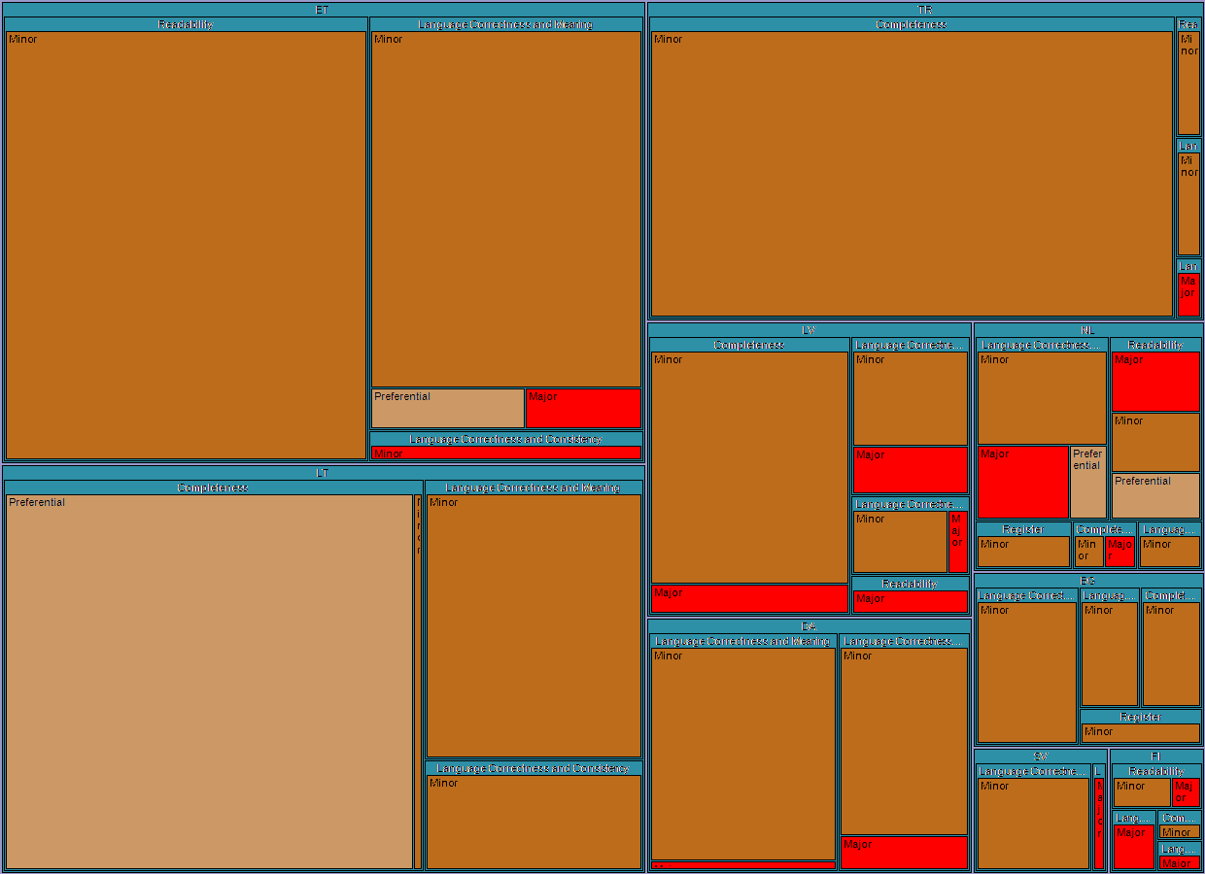
BI Visualisation

Slide 12
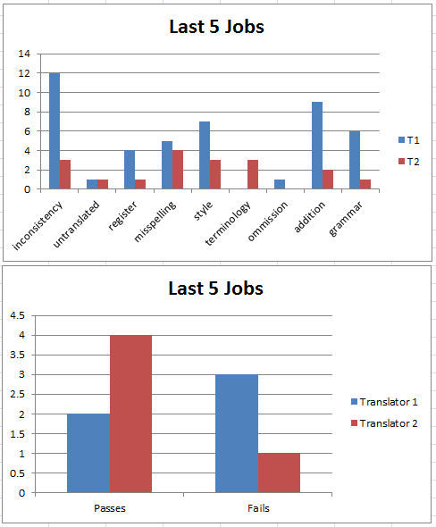
Run-time Intelligence

