Slide 1
MultilingualWeb-LT: Putting the World in the World-Wide Web
Arle Lommel
Deutsches Forschungszentrum für Künstliche Intelligenz (DFKI)

Slide 2
Some Background

Slide 3
The Vision of the World Wide Web
This works at the data level: you can access the Internet from (almost) anywhere in the world

Slide 4
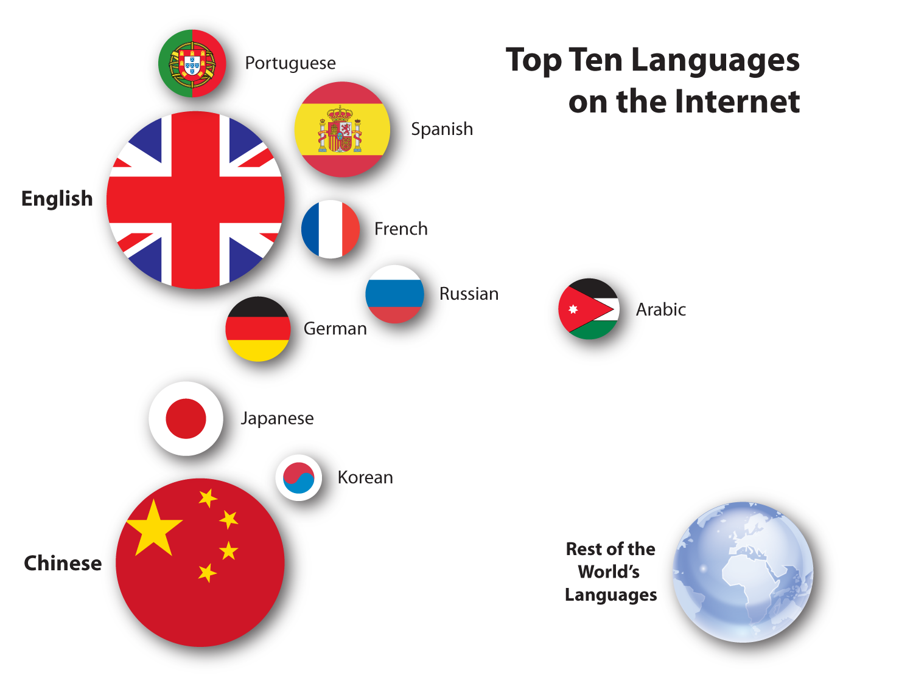
The Reality: Multiple Webs
Based on http://www.internetworldstats.com/stats7.htm

Slide 5
Multilingualism Becoming More Important
Since 2000:
Chinese grew ~1500%
Arabic grew ~2500%
Russian grew ~1800%
Top ten languages grew 421%
Rest of the world’s languages grew 589%
Critical issue in Europe
Based on http://www.internetworldstats.com/stats7.htm

Slide 6
Metadata
To reduce costs, we need to streamline the flow of data
Two ways
File level metadata (Linport)
Inline metadata

Slide 7
The MultilingualWeb-LT Project
Continuation of the MultilingualWeb project (http://www.multilingualweb.eu)
LT stands for “Language Technology”
A W3C standards effort
Funded by the European Commission

Slide 8
The MultilingualWeb-LT Project (2)
Addresses Web (HTML5) content
Addresses “deep Web” content (i.e., content in databases, CMSes, etc., that will appear on the Web)
Addresses relation to other standards (e.g., XLIFF)

Slide 9
MultillingualWeb Partners
Cocomore
Dublin City University
ENLASO
German Research Center for Artificial Intelligence (DFKI)
Institut Jožef Stefan
Linguaserve
Lucy Software and Services
Microsoft
Moravia
Trinity College Dublin
University of Economics, Prague
University of Limerick
Vistatec

Slide 10
Why Not Google Translate?
Quality is an issue
Lack of integration
No social interaction

Slide 11
Humans Are…
Very good at:
deduction
dealing with (implicit) context
adding intelligence
dealing with exceptions
Very bad at:
doing things quickly
doing the same thing over and over

Slide 12
Machines Are…
Very good at:
doing things quickly
doing the same thing over and over
Very bad at:
deduction
dealing with (implicit) context
adding intelligence
dealing with exceptions

Slide 13
Intelligence Creates Quality
To fix quality (for humans or machines), you need intelligence…
Intelligence allows you to deduce things you would not otherwise be able to understand
Should “Different Types of Windows Are Very Useful” be?
Verschiedene Arten von Windows sind sehr nützlich
Verschiedene Arten von Fenster sind sehr nützlich

Slide 14
If Machines Cannot Add Intelligence…
Then we need to make data intelligent
Apply what humans do well to enable machines to do what they do well

Slide 15
Examples
The “translate” attribute (already in HTML5):
<p>He bought a <span translate=“no”>Super Soaker™</span> water gun at <span translate=“no”>Joe’s Toy Emporium</span></p>
“Domain”:
Windows = Windows (IT)
Windows = Fenster (Construction)

Slide 16
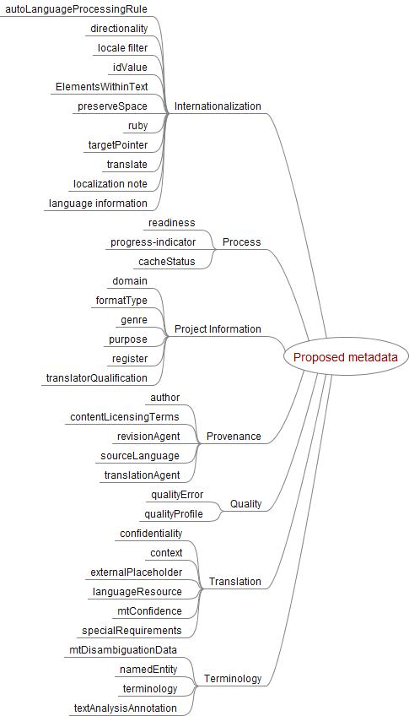
Proposed Scope

Slide 17
Intended Outcome
Lower barriers to information access
Lower cost of translation (for human translation)
Increase quality (for all translation)
Enable linking of data across languages (improve quality for all)

Slide 18
Options to Get Involved
MultilingualWeb homepage: http://www.multilingualweb.eu/
Join the MultilingualWeb Workshop http://www.multilingualweb.eu/documents/dublin-workshop/dublin-cfp
Contribute to the specification
Join the Working Group
Contact arle.lommel@dfki.de for more info

Slide 19
Any Questions?

