Slide 1
Education and Outreach Working Group
The impact of our resources
Jade Matos Carew
Head of Digital Accessibility and Usability
W3C in Europe, 6th February 2024

Slide 2
The power of the web…
…is in its universality. Access by everyone regardless of disability is an essential aspect.
Tim Berners-Lee, W3C Founding Director and inventor of the World Wide Web
The W3C vision is that the Web and related technologies are accessible so that people with disabilities around the globe can participate equally in the digital world.

Slide 3
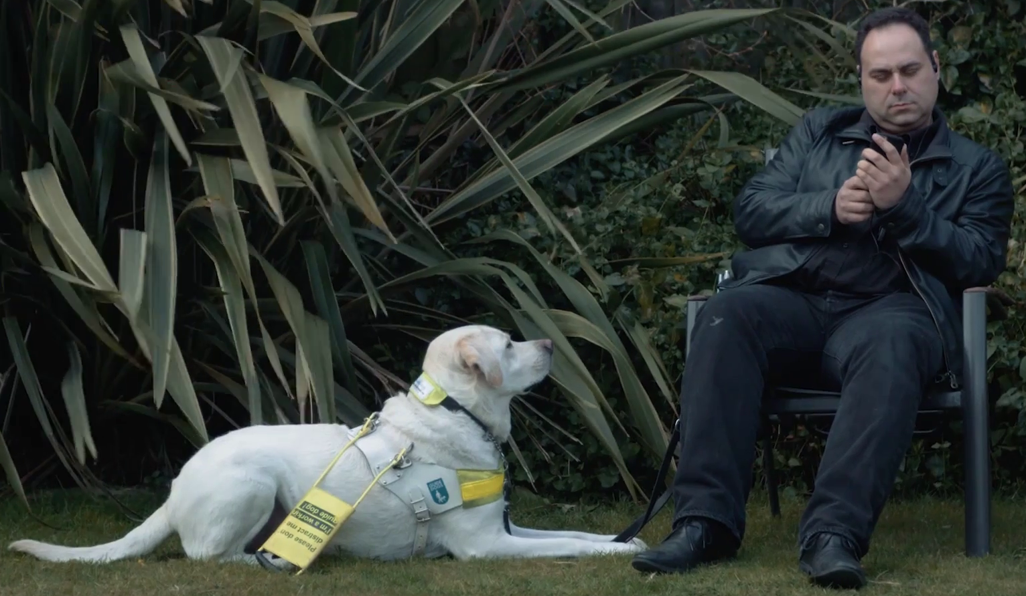
W3C’s Web Accessibility Initiative (WAI)
W3C’s Web Accessibility Initiative develops strategies, standards, and supporting resources to make the web accessible to people with disabilities.
It supports education and outreach and coordinates with research and development to promote harmonized, international uptake of web accessibility standards.

Slide 4
EOWG at a glance
EOWG produces resources to promote awareness, understanding, and implementation of web accessibility
We collaborate with and support other WAI working groups
We have a broad, global membership, bringing together a variety of skills and expertise

Slide 5
EO resources
Bridge the gap between technical and reality
Bring meaning to policy, law, and practice
Emphasise the importance of people with disabilities
Are the ‘gold standard’ of accessibility resources
Are a credible, reliable and trustworthy reference
Are flexible to suit a range of contexts

Slide 6
Current work
Lots of updates to existing resources:
(Easy Checks, How people with disabilities use the web, WAI Tutorials)
The impact of the European Accessibility Act (2019)
And a definitive anti-overlay stance in Europe by the European Commission
EO resources need to continue to be relevant, high quality, and anticipatory of audience needs.

Slide 7
Thank you
Thank you
group-eo-chairs@w3.org
Jade.matoscarew@open.ac.uk

