Slide 1
OGC SensorThings API
The new standard for collecting and managing sensor data
W3C TPAC, Joint meeting WoT & Spatial Data on the Web IG
23. October, Lyon, France
Michael Jacoby

Slide 2
What is the OGC SensorThings API?
A standard for exchanging sensor data and metadata.
“Sensor Web Enablement Light for IoT”
Like Sensor Observation Service (SOS), but:
RESTful
Using JSON
Adapting OASIS OData URL patterns and query language
Supporting MQTT messaging
Multiple parts
Part I: Sensing
Part II: Tasking Core
Part III: Rule Engine

Slide 3
What is special about it?
From technical perspective…
not much
mainly just combination of existing things
From practical perspective
Standardized way of managing sensors and observations in IoT
combining data model and API definition
simple, intuitive, powerful
Multiple existing implementations
Alternatives/Competing standards
More complex
SOS, oneM2M, FIWARE/NGSI
Covering only data model
SSN, iot.schema.org

Slide 4
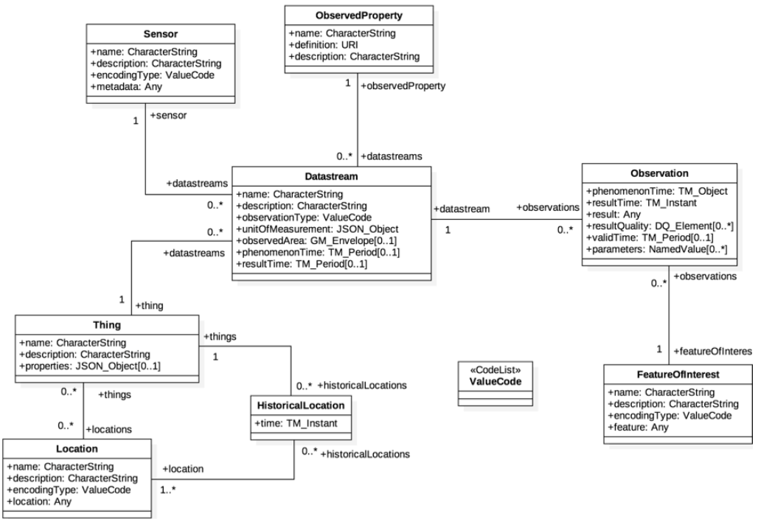
Data Model

Slide 5
API – URL patterns
Base URL: http://server.org/SensorThingsService/v1.0
GET
v1.0 → Get collection index
v1.0/Collection → Get all entities in a collection
v1.0/Collection(id) → Get one entity from a collection
v1.0/Collection(id)/property → Navigate along property of an entity
POST
v1.0/Collection → Create a new entity
PATCH
v1.0/Collection(id) → Update an entity
PUT
v1.0/Collection(id) → Replace an entity
DELETE
v1.0/Collection(id) → Remove an entity

Slide 6
API – URL patterns Example
GET all Things
http://server.org/SensorThingsService/v1.0/Things
Response
{
"value" : [
{
"name" : "My camping lantern",
"description" : "camping lantern",
"properties" : {
"property1" : "it’s waterproof",
"property2" : "it glows in the dark"
},
"Locations@iot.navigationLink" : "Things(1)/Locations",
"HistoricalLocations@iot.navigationLink": "Things(1)/HistoricalLocations",
"Datastreams@iot.navigationLink" : "Things(1)/Datastreams",
"@iot.id" : 1,
"@iot.selfLink" : "/SensorThingsService/v1.0/Things(1)"
},
{a second thing… }, { … }, { … }, { … }
],
"@iot.count" : 15,
"@iot.nextLink" : "/SensorThingsService/v1.0/Observations?$skip=5"
}

Slide 7
API – Query options
Based on OData
Options
$top
$skip
$count
$orderby
$select
$expand
$filter

Slide 8
API – Example Queries
HTTP GET http://example.org …
Paging
/v1.0/Observations?$top=4&$skip=12&$count=true
$select
/v1.0/Things?$select=@iot.id,description
$expand
/v1.0/Things(17)?$expand=Datastreams
/v1.0/Things(17)?$expand=Datastreams($expand=Observations)
Filter
/v1.0/Observations?$filter=result gt 5

Slide 9
API – Functions
Comparison:
gt: >
ge: >=
eq: =
le: <=
lt: <
ne: !=
Logical:
and
or
not
Mathematical:
add
sub
mul
div
mod
String Functions:
substringof(p0, p1)
endswith(p0, p1)
startswith(p0, p1)
substring(p0, p1)
indexof(p0, p1)
length(p0)
tolower(p0)
toupper(p0)
trim(p0)
concat(p0, p1)
Mathematical:
round(n1)
floor(n1)
ceiling(n1)

Slide 10
API – Functions
Geospatial:
geo.intersects(g1, g2)
geo.length(l1)
geo.distance(g1, g2)
st_equals(g1, g2)
st_disjoint(g1, g2)
st_touches(g1, g2)
st_within(g1, g2)
st_overlaps(g1, g2)
st_crosses(g1, g2)
st_intersects(g1, g2)
st_contains(g1, g2)
st_relate(g1, g2)
Date and Time:
now()
mindatetime()
maxdatetime()
date(t1)
time(t1)
year(t1)
month(t1)
day(t1)
hour(t1)
minute(t1)
second(t1)
fractionalseconds(t1)
totaloffsetminutes(t1)

Slide 11
OGC SensorThings API and W3C WoT
Semantics in STA
SSN/SOSA
JSON-LD (WG was in contact with OData?)
STA as use case for WoT TD
Security (not a topic in STA so far)

Slide 12
OGC SensorThings API and W3C WoT
OGC STA and W3C WoT are not competitors
STA can be seen as an IoT platform API
use WoT TD

Slide 13
OGC SensorThings API and W3C WoT
OGC STA and W3C WoT are not competitors
STA can be seen as an IoT platform API
use WoT TD
Read
HTTP GET http://example.com/STA/v1.0/Sensors(1)/name/$value
Write
HTTP PATCH http://example.com/STA/v1.0/Sensors(1) BODY {"name": “new value"}
Subscribe
MQTT topic=Sensors(1)/name
How to model this with WoT TD?

Slide 14
Questions?
Try it out in 3 steps powered by
> wget https://github.com/FraunhoferIOSB/ FROST-Server/blob/master/docker-compose.yaml
> docker-compose up
open http://localhost:8080/FROST-Server/v1.0

