Slide 1
SECURITY VISION IN W3C
Judy Zhu (AB Mmeber, Alibaba Group)

Slide 2
Contents
Security risks
Standard requirements
Current security work in W3C
Call for actions about W3C security work
Summary

Slide 3
Top 10 most critical web application security risks in 2017
A1: Injection
A2: Broken Authentication and Session Management
A3: Cross-Site Scripting (XSS)
A4: Broken Access Control
A5: Security Misconfiguration
A6: Sensitive Data Exposure
A7: Insufficient Attack Protection
A8: Cross-Site Request Forgery (CSRF)
A9: Using Components with Known Vulnerabilities
A10: Underprotected APIs
Note: Extracted from OWASP (Open Web Application Security Project)

Slide 4
Some security problems from Chinese market
There are 9000 new mobile virus samples emerging every day, almost 6 per minute.
Two-factor authentication with SMS verification code is not secure any more.
Virus attacks become hidden and have more variety.
89% of popular mobile apps have fake apps.
98% of mobile apps have security vulnerabilities among top 10 mobile apps in 18 industries.
Financial industry bank category has more fake apps.
Security vulnerabilities from game industry are increasing relatively fast.
1
2
3
4
5
6
7
Note: Extracted from Alibaba JAQ 2016 Annual Security Report
Notes:
1. There are 9000 new mobile virus samples emerging every day, almost 6 per minute.
2. Two-factor authentication is not secure any more.
3. Virus attacks become hidden and have more variety.
4. 89% of popular mobile apps have fake apps.
5. Financial industry bank category has more fake apps.
6. 98% of mobile apps have security holes among top 10 mobile apps in 18 industries.
7. Security holes from game industry are increasing relatively fast.

Slide 5
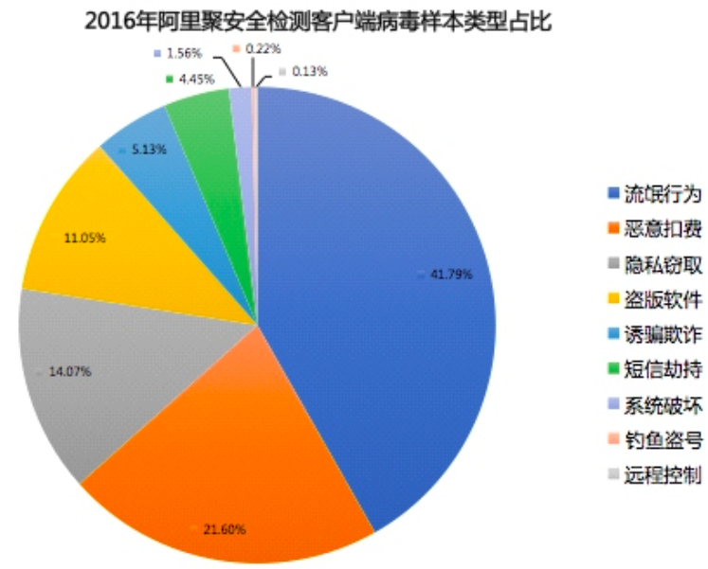
Some security statistics from Chinese market -1
Mobile client virus sample type percentages in 2016
Immoral behavior
Malicious charge
Privacy leakage
Pirate application
Trap and fraud
SMS hijacking
System destroy
Phishing hacking
Remote control
Note: Extracted from Alibaba
JAQ 2016 Annual Security Report.

Slide 6
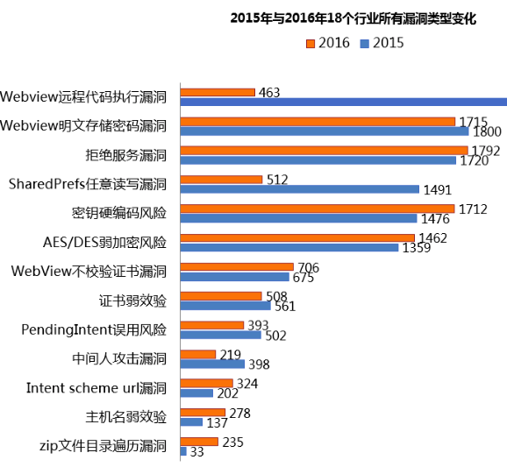
Some security statistics from Chinese market -2
Security vulnerability type changes from 2015 to 2016
Webview remote code execution
Webview unencrypted password storage
Denial of service
SharedPrefs arbitrary read and write
Hard encoded secret key risk
AES/DES weak encryption risk
Webview no certificate verification
Weak certificate verification
PendingIntent mistaken usage risk
Middleman attack
Intent scheme url security vulnerability
Note:
Extracted from Alibaba JAQ 2016 Annual Security Report
Host name weak verficiation
zip file directory ergodic

Slide 7
Standard requirements in security
Why
What
How
Traditional authentication is vulnerable
Stronger Authentication
Multi-factor authentication, Biometric authentication
More IOT devices, more influence to our lives
IOT Security
Authentication, Authorization, Anti-DDoS
Web environment is essential to internet. Web security is crucial
Web Security and Web App Security
Content Security Policy, Web Cryptography, Credential Management
Personal information leakage leads to internet fraud.
Privacy Protection
Encryption, de-sensitization, de-identification
Notes:
去掉

Slide 8
Current security work in W3C -1
Groups | Completed Work |  | Drafts
 | Recommendation | Group Note | Candidate Recommendation | Working Draft
Web App Security WG | 3 (CSP Level 2, Subresource integrity, Cross-origin Resource Sharing) | 4 (CSP 1.0, CSP: Cookie Control, CSP Pinning, Entry Point Regulation) | 4 (Referrer Policy, Secure Contexts, Mixed Content, Upgrade Insecure Requests) | 10 (CSP Level 3, Clear Site Data, Credential Management Level 1, etc.)
Web Authentication WG |  |  |  | 1 (Web Authentication API)
Web Cryptography WG | 1 (Web Cryptography API)
Privacy IG |  | 1 (Fingerprinting Guidance for Web Specification Authors)

Slide 9
Current security work in W3C -1
Web Application Security WG
Re-charter was approved on 22 March, 2017:
https://www.w3.org/2011/webappsec/charter-2017.html
Charted new work: Vulnerability Mitigation, Attack Surface Reduction, and Web Security Model.
CSP (Content Security Policy) Level 2 was published as Recommendation on 15 Dec, 2016:
https://www.w3.org/TR/2016/REC-CSP2-20161215/
Development is ongoing for CSP Level 3:
https://www.w3.org/TR/CSP/
Web Authentication WG
Actively developing the Web Authentication API:
https://www.w3.org/TR/webauthn/
Notes:
1. Vulnerability Mitigation：use mechanisms to reduce the scope and impact of common vulnerabilites and vulnerability classes in web applications.
2. Attack Surface Reduction: design mechanisms to reduce the possibilities to attack the web applications.
3. Web Security Model: Define fundamental security model of the Web Platform.
4. Content Security Policy: A policy language intended to enable web designers or server administrators to declare a security policy for a web resource.
详细的介绍可以参见：https://www.w3.org/2011/webappsec/charter-2017.html
5. Web Authentication API：It defines an API to enable the creation and use of strong and encrypted credentials by web applications.
详细的介绍可以参见：https://www.w3.org/TR/webauthn/

Slide 10
Current security work in W3C -2
Web Cryptography WG
Web Cryptography API was published in Jan, 2017:
https://www.w3.org/TR/WebCryptoAPI/
WG is now closed, and maintenance work happens under the supervision of the Web Security IG.
Web Security IG
Re-charter was approved in Jan, 2017:
https://www.w3.org/2017/03/security-ig-charter.html
Chartered work: Incubate new ideas, Horizontal Reviews, Web Security Incident Review.
Privacy IG
Chartered deliverable: Privacy Considerations for Web Standards.
Ongoing work: privacy questionnaire, fingerprinting guidance, privacy reviews.
Notes:
1. Web Cryptography API: It describes a JavaScript API for performing basic key management operations in web applications, such as hashing, signature generation and verification, and encryption and decryption.
2. Incubation: Discussing ideas for new Recommendation-track work; dispatching promising ideas to a Community Group or Task Force; proposing drafts to W3C for Working Group chartering.
3. Horizontal Reviews: Assessing W3C drafts for security considerations and/or publishing questionnaires or other guidance to enable self-review by working groups.
4. Web Security Incident Review: Considering reported security incidents as input, e.g., to correct patterns of error, threat modeling, and new spec development.
5. Privacy questionnaire: list some questions related to privacy protection for the document authors to consider.
5. Fingerprinting guidance: Provide guidance about the capability of a site to identify or re-identify a visiting user, user agent or device by configuration settings or other observable characteristics.
https://www.w3.org/2011/07/privacy-ig-charter

Slide 11
Call for actions about W3C security work
Call for actions
Directions
Improve security considerations or reviews
Some specs don’t have carefully written security considerations.
The written security considerations don’t get enough reviews.
Build security review community
Process considerations
Outreach to researchers
Improve participation in some security groups
Web security IG
Privacy IG
Enhance participation
Invite external experts
Security educations
Incubation
Get inputs from vertical industry
Utilize CGs to discuss new ideas
New standard topics need to be explored to address new security challenges
Stronger authentication (Human ontology authentication)
IOT security
Blockchain security
We also welcome inputs from AC members!

Slide 12
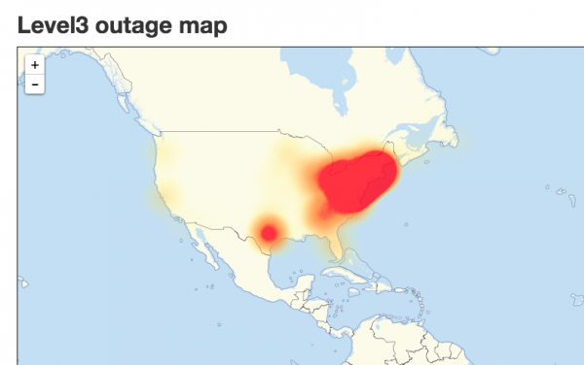
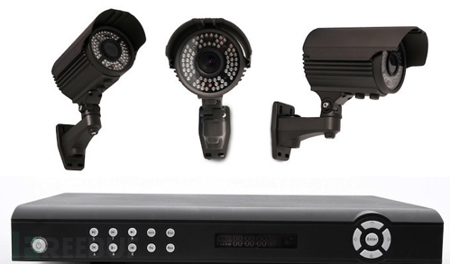
IOT Security
Security Accidents
Examples
In 2014, remote code execution vulnerability, affected more than 150000 Webcam devices, because of weak password.
October 21, 2016, DDoS attack to Dyn’s Managed DNS infrastructure.
Secure
Booting
Access
Control
Anti-
DDoS
Security
Requirement
Device Authentication
Secure Software Updates and Patches

Slide 13
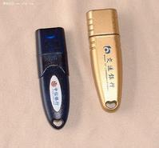
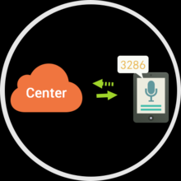
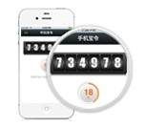
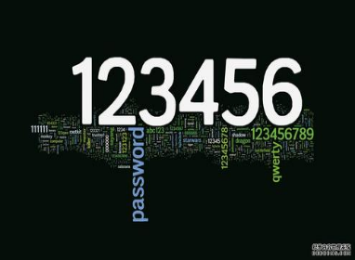
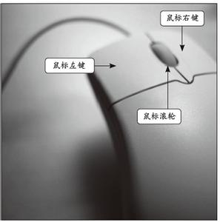
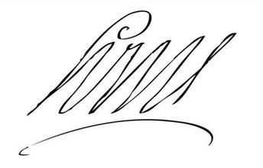
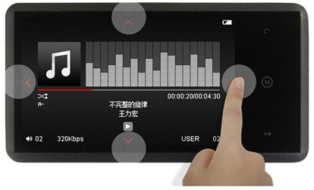
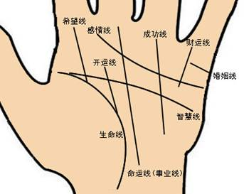
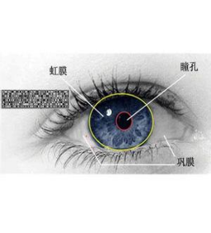
Stronger authentication
USB Key
SMS Code
OneKey
Confirmation
OTP Token
Web API for “Human ontology authentication” ?
Advantages
Portable
Secure
Stable
Unique
Universal
Convenient
Collective
Acceptable
Keyboard Pressing
Mouse moving track
Handwriting
Finger Pressing
Fingerprint
Palmprint
Iris
Face

Slide 14
Suggestions for future work
Utilize internal (e.g. Privacy IG, Web Security IG) and external (e.g. IETF) security resources.
Invite external experts to share their security issues, challenges, technology trends, etc.
People
Use security related IGs to incubate new ideas.
Encourage early participation in vertical groups, e.g. IOT, Web Payments.
Process
Encourage the usage of security and privacy questionnaire;
Organize workshops to explore new security standard topics.
Technology

Slide 15
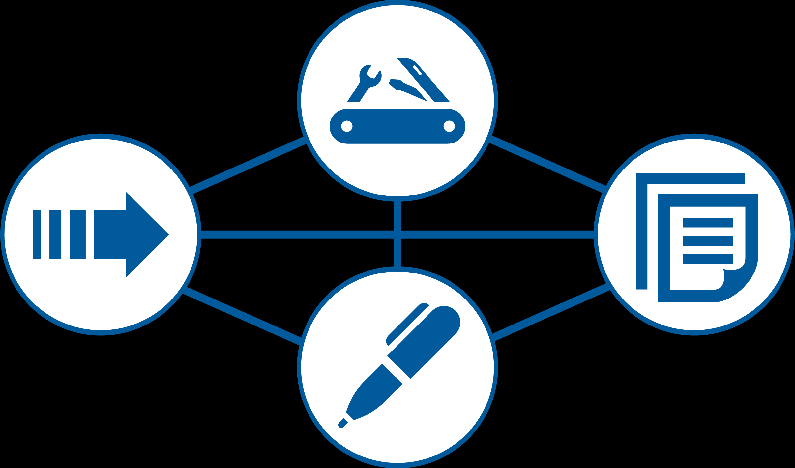
Summary
Improve security review
Utilize security and privacy questionnaire
Review from W3C security community
Review from external security experts
Enhance security participation
Give enough staff resource support
Give high priority to security work
Absorb industry standard requirements
Explore new security standard topics
IOT security
Blockchain security aspects
Human ontology authentication
Notes:
1、IOT的安全（具体是什么，智能家居的问题，典型的，穿插到前面）；
2、实人认证（攻击的场景）；
3、区块链安全（讲具体的问题，追溯，供应链，加一个图）；
4、AI的安全（具体什么样的问题）；太虚。
5、提一些有新意的东西；加强深度；
6、格式再改一下。
7、不要四个例子都展开，拿一个具体的案例来展开。
Procedures；
Community Review：小的意见。
AB的意见：
细节的讨论意见？
总结一件。
第7页；11、12、13、14页。
开会的群，时间和地点。Schedule。明天周一。

Slide 16
My “standard” formula
Excellent Standard = f（Urgent Problem，Solid Technology, Implementation, Testing, Standard Writing）

Slide 17
A standard poem
Note: Before Chairman Mao had a poem, nowadays we changed the words but referred to his style and format.
沁园春●标
忆往昔，唇枪舌剑，到处有高招
俱往矣，运筹帷幄，见招拆招
数风流人物，还看今朝
不管国标、行标、还是啥标，只要有用，都是好“标”！
Translation:
Qinyuanchun ● Standards
Recalling the past, debates and discussion, brilliant ideas everywhere
All these gone, strategy and tactics, handling problems case by case
But if looking for more truly great people, still need rely on the people nowadays
Whatever national standard, industry standard or anything else, as long as they are useful, they are good standards!

Slide 18
The Future of W3C and China Market
China Market
W3C

Slide 19
Thank you for listening!

